Slide 1
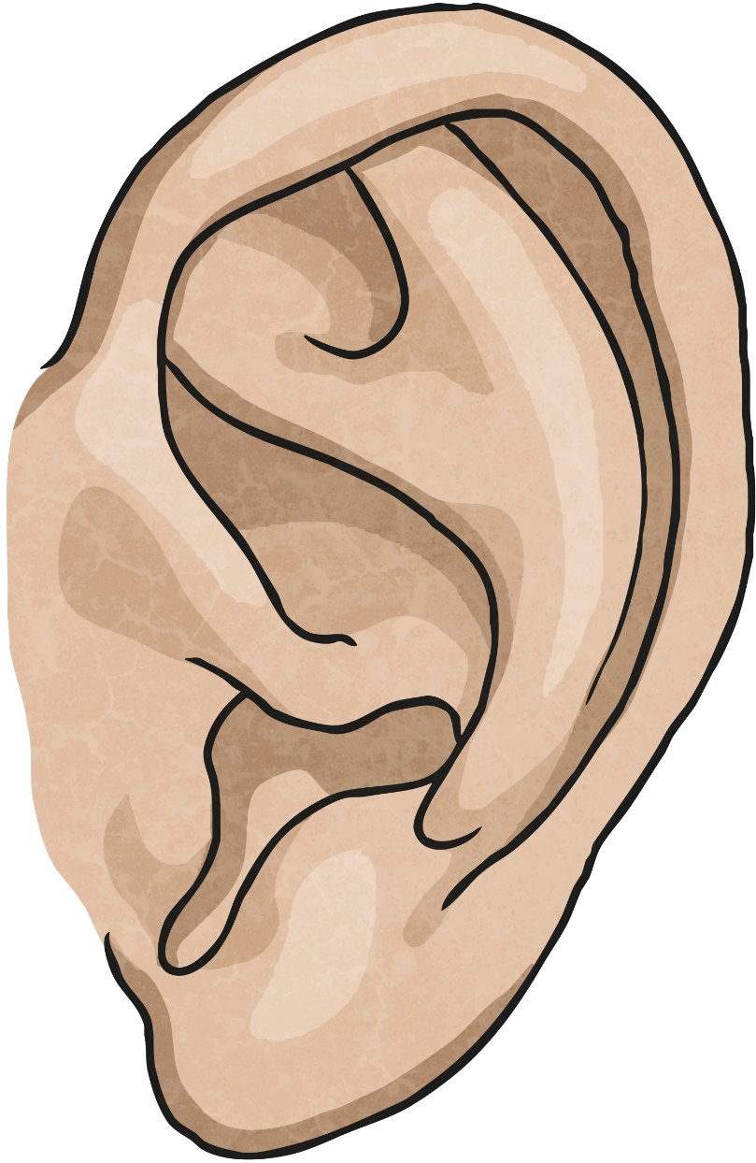
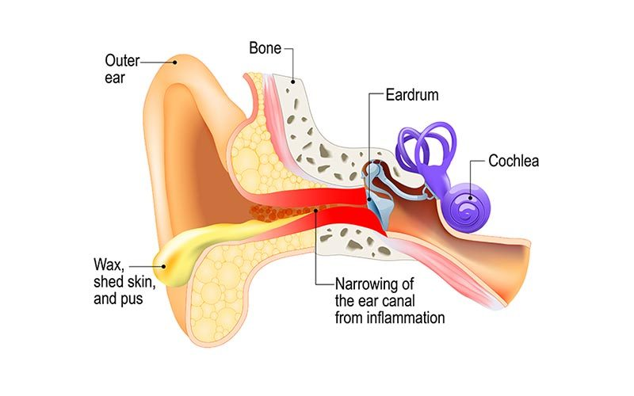
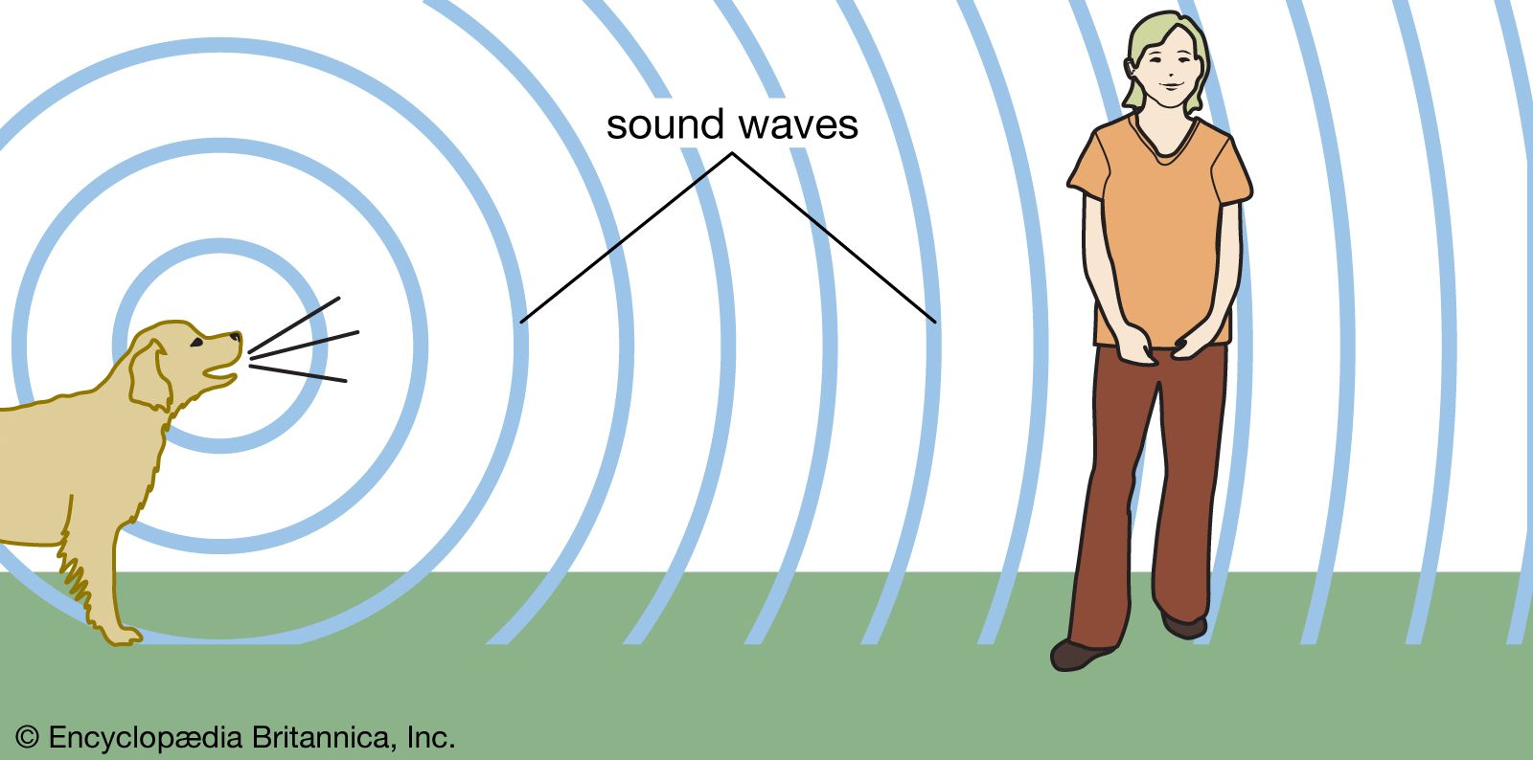
Sound – Year 4
Things I should already know
The five senses.
Different volumes of sound.
Describe different sounds by their pitch and volume.
Vocabulary
ear | The ear is an organ that allows humans and animals to hear.
distance | Distance is a measure of the length between two points.
volume | Volume is a measure of how loud a sound is.
vibration | A vibration is a very quick, continuous movement.
pitch | Pitch is a measure of how high or low a sound is.
At the end of my learning I will know
The different parts of the ear.
All sounds are created by vibrations.
These vibrations travel through the air particles into our ears. When they reach the eardrum and inner ear, sounds can be heard.
These vibrations are called sound waves and can travel through any medium, including solids, liquids and gases.

