Slide 1
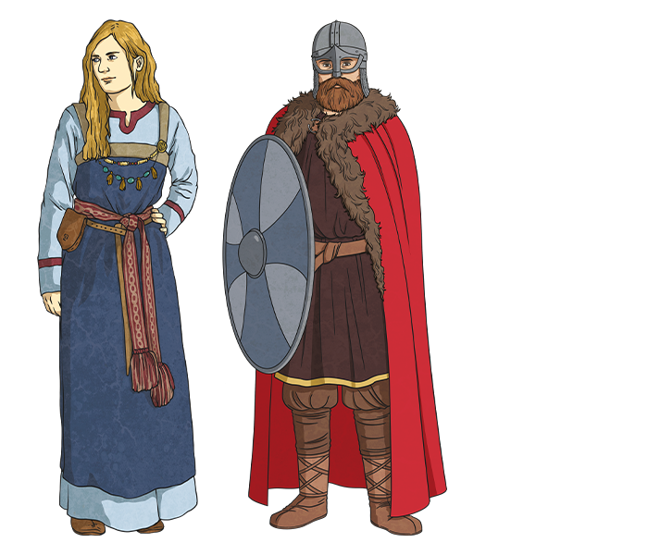
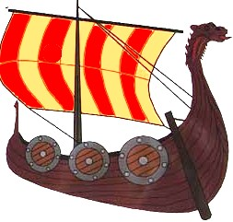
Invaders and settlers – Year 4
Things I should already know
Many of the places where people live today have existed for hundreds or even thousands of years.
Early settlers including the Romans.
Vocabulary
Invaders | A person or group that invades a country, region, or other place
Settlers | A person who moves with a group of others to live in a new country or area
Scandinavia | A group of countries in northern Europe that includes Denmark, Norway and Sweden
Monastery | A building or buildings occupied by a community of monks living under religious vows.
Monk | A member of a religious community.
settlement | A village, town or city where people live.
At the end of my learning I will know
The Anglo-Saxons were warrior-farmers and came from north-western Europe. They began to invade Britain while the Romans were still in control.
The Vikings were invaders and settlers who came from Scandinavia and travelled by boat.
The word “Viking” meant “pirate raid”. They were famous for raiding monasteries.
The reason Britain was invaded and settled on was because of its rich source of resources, land and gold.
Alfred the Great was a Saxon king who prevented England from falling to the Danes

