Slide 1
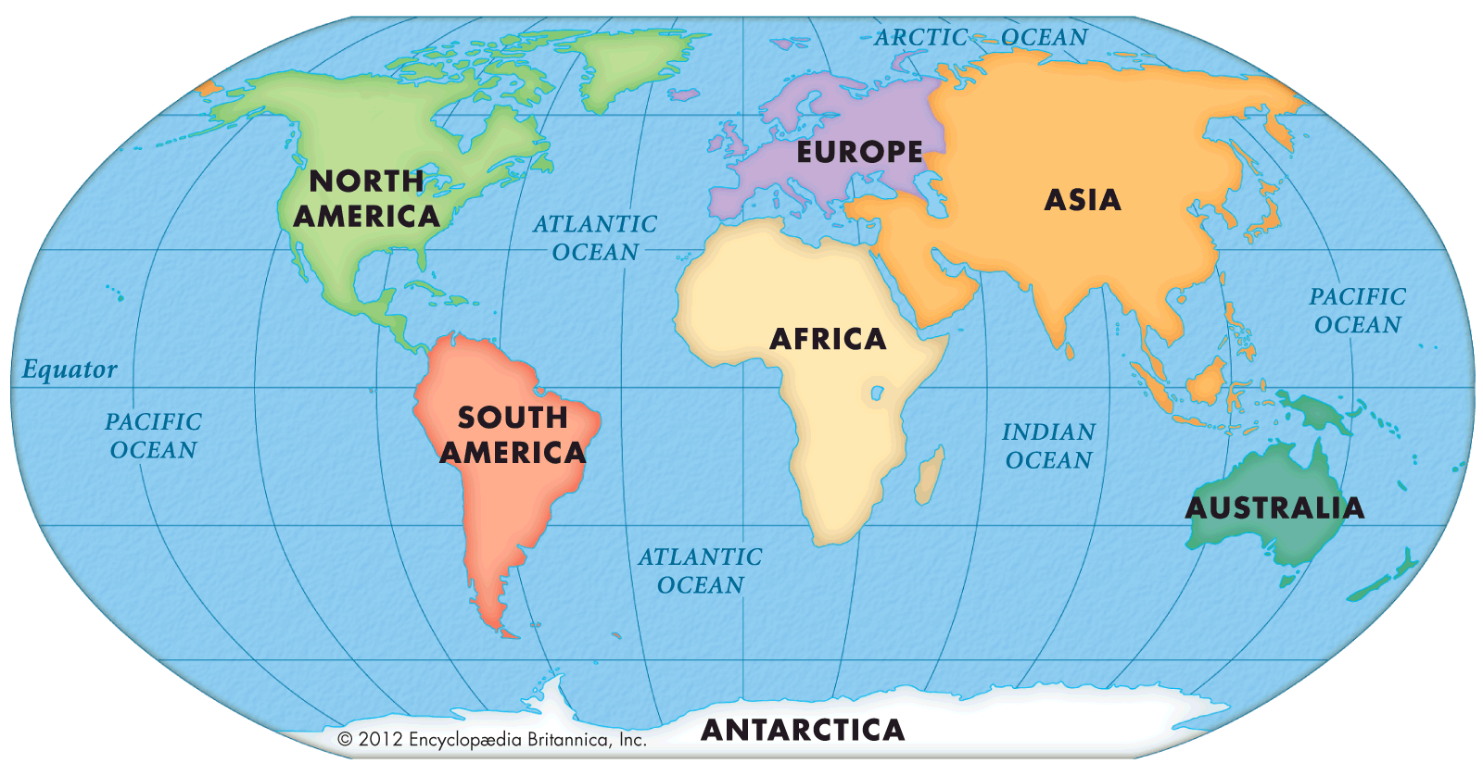
The World – Year 2
Things I should already know
London is the capital city of England
The four countries of the United Kingdom
A map shows land and water, and identify both
The months of the year
The seasons of the year
Word | Meaning
Sea | A large body of salt water.
Ocean | A very large area of sea.
Continent | A group of countries that are connected.
Equator | An imaginary line around the centre of our planet that splits it into the North and South.
North Pole and Soth Pole | North Pole – the northern most point of our planet. South Pole – the southern most point of our planet.
Season | Spring, Summer, Autumn and Winter
At the end of my learning I will:
Identify the seas and countries of the United Kingdom on a map
Find and label the five oceans of the world on a map and a globe
Find and label the seven continents of the world on a map and a globe.
Identify the Equator and the two Poles on a globe
Explain the features of the different seasons of the United Kingdom

