Slide 1
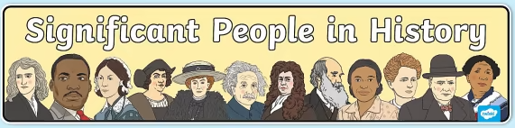
Significant people – Year 2
Things I should already know
History is the study of things that have happened in the past
We learn about the past from sources such as diaries, stories, photographs and objects
How my life has changed since I was a baby
How the lives of people in your family have changed over time
Some people are significant for things such as inventions, music and sport
The names of some significant people and why they are famous
Word | Meaning
Significant | A person, place or object that is important.
Chronological | The time order that things happened in.
Evidence | Clues that tell us about the past.
Predictions | A sensible guess based on evidence.
At the end of my learning, I will:
Give reasons a person from the past is significant today
Put the key events of a person’s life into chronological order
Explain different ways of travelling in the past and compare them to today
Ask questions based on sources of evidence
Make predictions based on sources of evidence
Important
Amazing
Explorers
Discovery
Kindness
Bravery

