Slide 1
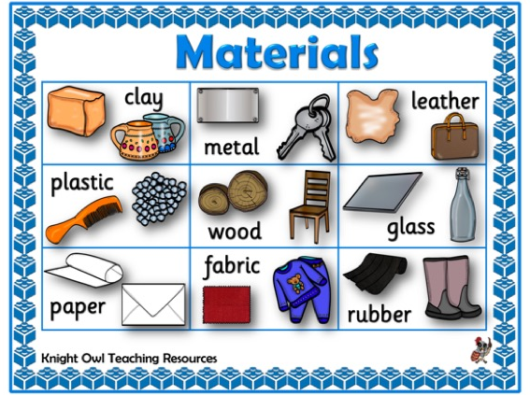
Everyday materials – Year 2
Things I should already know
What an object is made from
Identify and name a variety of everyday materials
Describe some materials using their properties
Group materials together
Twisting
Squashing
Suitability
Bending
Vocabulary
Suitability | How appropriate it is for the purpose.
Comparisons | Seeing what is similar and different between two or more things.
Materials | The thing that objects are made out of.
WOOD GLASS PAPER FABRIC PLASTIC CARDBOARD METAL
At the end of my learning I will know
Compare materials and describe why/how they are suitable for particular purposes
Know how materials can be changed by squashing, bending, twisting and stretching

