Slide 1
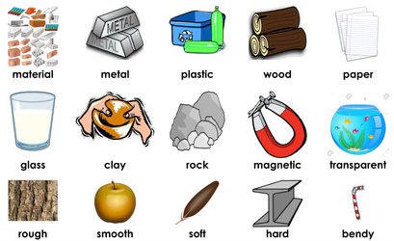
Properties of Materials – Year 5
Things I should already know
Describe the simple physical properties of some materials.
Identify and name a variety of everyday materials.
Compare and group together a variety of everyday materials on the basis of their simple physical properties
Identify the suitability of a variety of everyday materials for particular uses.
Know how the shapes of solid objects made from some materials can be changed by bending, twisting and stretching.
At the end of my learning I will know
How to compare and group together everyday materials on the basis of their properties, including hardness, solubility, transparency, conductivity and response to magnets.
know that some materials will dissolve in liquid to form a solution, and describe how to recover a substance from a solution.
give reasons, based on evidence from comparative and fair tests, for the particular uses of everyday materials, including metals, wood and plastic.
Vocabulary
Insulator | A material that doesn’t let electricity or heat pass through it.
Conductor | A material that allows electricity and heat to pass through it easily.
Transparent | A material that allows light to completely pass through it so that things can be seen clearly through it.
Opaque | Materials that don’t allow any light to pass through.
Soluble | A material, that when mixed with a liquid, breaks down into tiny particles that can’t be seen.
Solution | The result of a soluble substance dissolving into a liquid.

