Slide 1
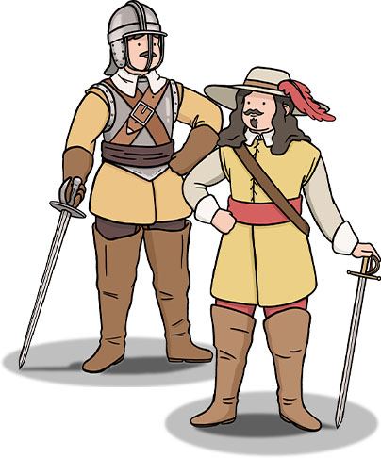
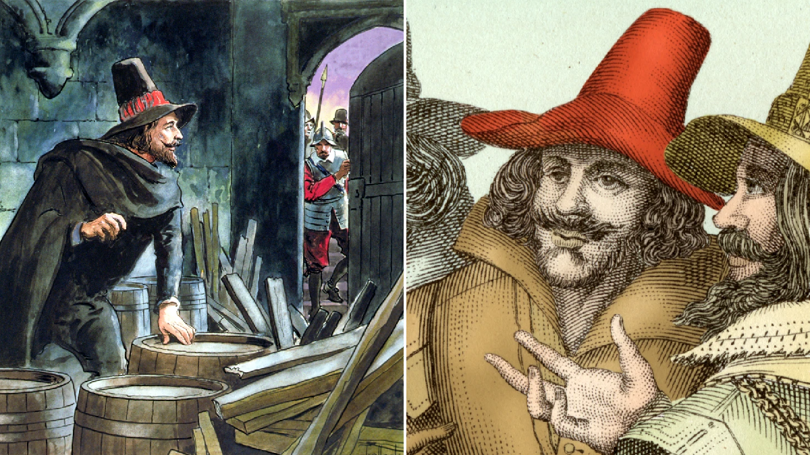
The Stuarts – Year 5
Things I should already know
British history prior to 1600 and how people’s lives have shaped the nation.
How Britain has been influenced by the wider world.
The role of Kings and Queens and their links to religion.
A knowledge of ancient civilisations and their contributions to society.
Key Vocabulary
Monarchy | A system of government where usually one person reigns, usually a King or Queen. This role is usually inherited.
Civil War | A war between people of the same country. Often they have very different ideas about how the country should be run.
Plague | A disease that spreads quickly and kills many.
Divine | ‘Of God’ or ‘Relating to God’
Government | The people responsible for running the country. They are from one political party and consist of the Prime Minister and his cabinet ministers.
Parliament | People who are elected to represent the public when deciding on new laws or taxes.
At the end of my learning I will know
Analyse King James I belief in the divine right.
Identify how Guy Fawkes's actions could have changed the path of History.
Compare the Roundheads and Cavaliers during the civil war and how this fits with local history.
Use historical sources to decide whether Oliver Cromwell was a hero or a villain.
Learn why the plague spread so quickly and its similarity and differences with Covid 19.

