Slide 1
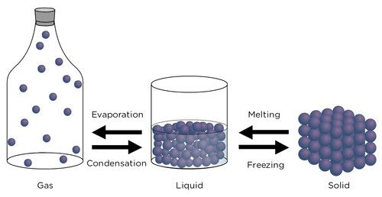
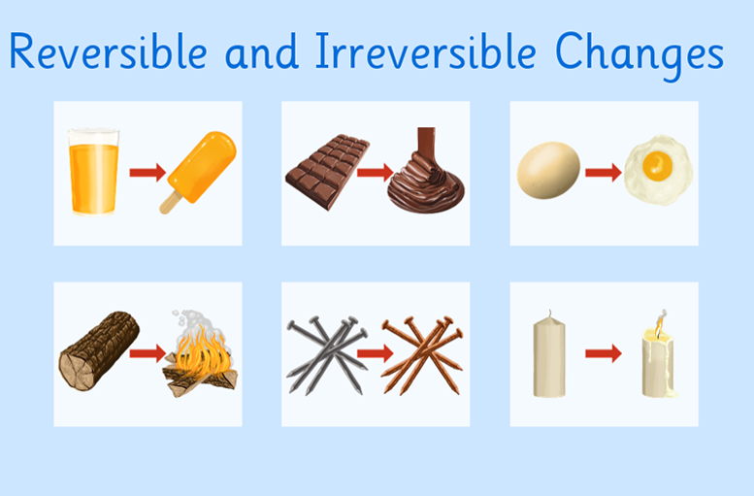
Changes in Materials – Year 5
Things I should already know
That there are a variety of common animals including fish, amphibians, reptiles, birds and mammals
That animals can be carnivores, herbivores and omnivores
Know the structure of a variety of animals
Know the basic parts of the human body which parts link to each sense
Vocabulary
Reversible | To change a material back to its original state.
Irreversible | When a material can’t be changed back to its original state.
Separate | To remove/isolate each component in a mixture or solution.
Evaporate | When a liquid changes into a gas.
Soluble | A material, that when mixed with a liquid, breaks down into tiny particles that can’t be seen.
Solution | The result of a soluble substance dissolving into a liquid.
Change of state | When matter switches between solid, liquid and gas forms, through heating and cooling.
At the end of my learning I will know
Know that some materials will dissolve in liquid to form a solution, and describe how to recover a substance from a solution.
Use knowledge of solids, liquids and gases to decide how mixtures might be separated, including through filtering, sieving and evaporating.
Demonstrate that dissolving, mixing and changes of state are reversible changes.
Explain that some changes result in the formation of new materials, and that this kind of change is not usually reversible.

