Slide 1
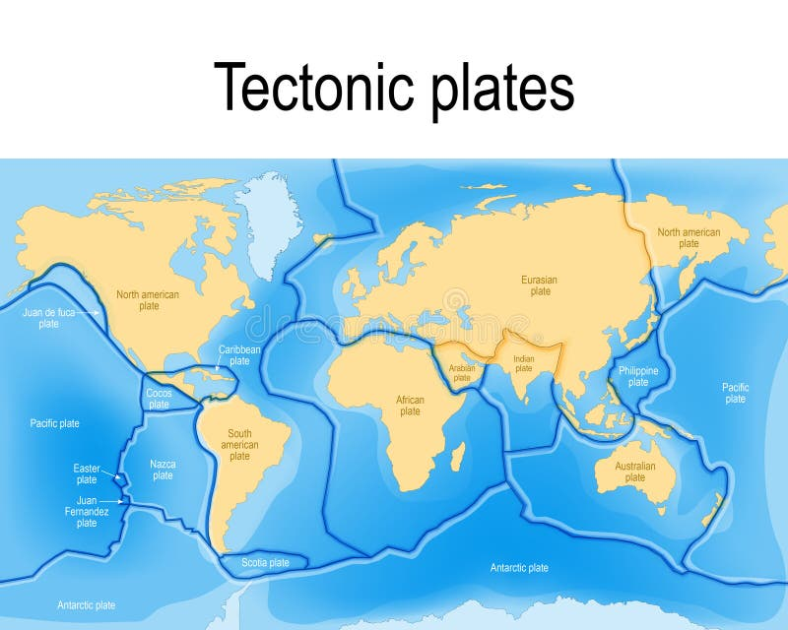
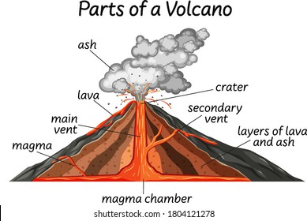
Volcanoes– Year 5
Things I should already know
How to use maps, atlases and globes to locate the world’s continents and countries.
Understand the meaning of human and physical characteristics in Geography.
Identify the capital cities for the UK countries
Identify the world’s oceans.
Know that places can be hot or cold depending on their proximity to the equator.
Key Vocabulary
Lithosphere | The Earth’s outer shell made up of the crust and the upper mantle.
Asthenosphere | The soft, flowing layer of the Earth beneath the Lithosphere. This layer enables the tectonic plates to move.
Magma | Hot molten (liquid) rock that lies beneath the Earth’s surface.
Lava | Magma that flows out onto the Earth’s surface from a volcano.
Tectonic plates | The Earth’s surface broken into large chunks that can move slowly to create mountains, volcanoes and earthquakes.
Active | A volcano that has erupted recently or is likely to erupt in the future.
Dormant | A volcano that hasn’t erupted in a long time, but still has a magma supply, so could possibly erupt in the future.
Extinct | A volcano that has not erupted in a vary long time, so it is extremely unlikely to erupt in the future.
At the end of my learning I will know
Key aspects of physical geography- volcanoes
How to identify the layers of the Earth.
How volcanoes are formed.
What the relationship is between tectonic plates and volcanoes
The structure of a volcano.
The 4 main types of volcano and why they are different shapes.
To classify volcanoes as active, dormant or extinct.
What the benefits and disadvantages are of living near a volcano.

