Slide 1
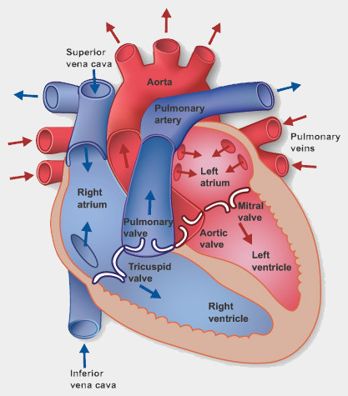
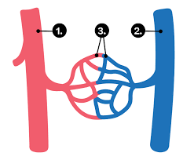
Animals, Including humans – Year 6
Things I should already know
The importance for humans of exercise, eating the right amounts of different types of food, and hygiene
Identify that animals, including humans, need the right types and amount of nutrition, and that they cannot make their own food; they get nutrition from what they eat.
Describe the simple functions of the basic parts of the digestive system in humans.
Identify the different types of teeth in humans and their simple functions.
Key Vocabulary
Heart | The organ that pumps blood around the body.
Pulse | the throbbing of your arteries as blood moves through them.
Blood | the liquid that transports nutrients throughout the body and removes waste.
Blood Vessels | tubes through which blood flows around the body
Lungs | one of a pair of organs in the chest that supplies the body with oxygen, and removes carbon dioxide from the body.
Oxygen | The air in which we breathe, in order to survive.
Carbon Dioxide | a chemical compound that is usually in the form of a gas.
Circulatory System | a network of organs and blood vessels that work together to circulate blood throughout the body
Diet | Diet is the type and range of food that you eat regularly
Drugs | substances that change the way our bodies work
Lifestyle | the way they choose to live.
At the end of my learning I will know
How the heart pumps blood around the body
How oxygen, nutrients and water travel through the body
Diet, exercise, drugs and lifestyle have an impact on the way our bodies function

