Slide 1
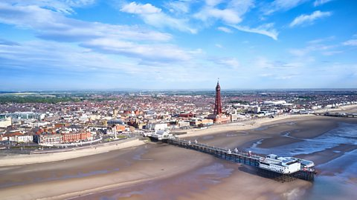
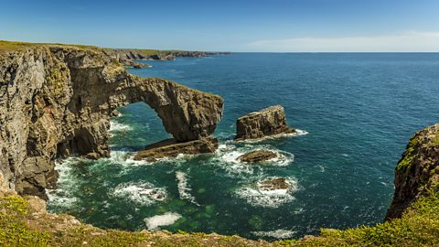
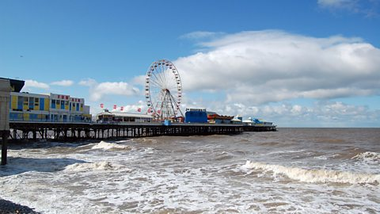
Coastal Study – Year 6
Things I should already know
The surrounding seas within the UK
Seasonal and weather patterns
Oceans within the world
Where Blackpool is and its human and physical features
Natural disasters
Symbols and keys within maps
At the end of my learning I will know
The eight points of a compass
How to use 4 and 6 figure grid references
Physical and human impacts on coastal erosion and pollution
Ordnance survey map usage and the keys and symbols
Key Vocabulary
Coastal Erosion | The wearing away of the land by the sea, often through powerful waves.
Coastline | The line that forms the boundary between the land and the ocean.
Human Effects | how people's actions, both positive and negative, impact the environment.
Physical Effects | the changes that natural processes (like weather, erosion, or earthquakes) have on the Earth's surface and the things that live there.
OS Map | maps show physical and human features as symbols. This makes the maps easier to read. Each OS map has a key to show what the symbols mean.
Natural Features | the physical elements of the Earth's surface that exist naturally
Grid References | a system used to pinpoint a specific location on a map using horizontal and vertical lines.
Compass | a tool used to find direction, helping you navigate by pointing towards north

