Slide 1
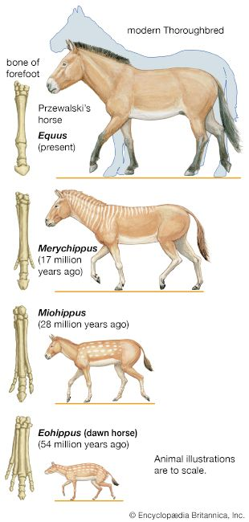
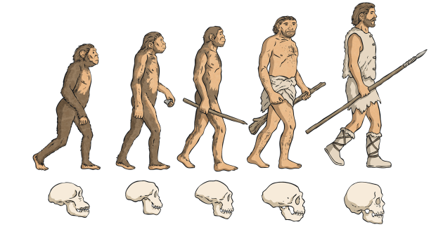
Evolution – Year 6
Things I should already know
Know that most living things live in habitats to which they are suited and describe how different habitats provide the basic needs
Notice that animals, including humans, have offspring which grow into adults.
Describe in simple terms how fossils are formed when things that have lived are trapped within rock.
Recognise that environments can change and that this can sometimes pose dangers to living things.
Key Vocabulary
Offspring | The younger of an animal, humans and plants
Vary | Something that can change
Characteristics | a feature or quality that helps to identify or describe something
Adapted | a modification of an organism or its parts that makes it more fit for existence
Environment | the surroundings or conditions that a living organism (people, animals, plants) finds themselves in.
Inherited | characteristics that are passed down from parents to offspring through genes
Species | a group of similar organisms that can breed with one another to produce fertile offspring.
Fossils | the preserved remains or traces of a plant or animal that lived long ago
Evolution | the process where living things change gradually over a long period of time
At the end of my learning I will know
All living things have offspring of the same kind, features are inherited but are not identical and vary from each other.
Plants and animals have characteristics that make them suited their environment.
Fossils give us evidence of what lived on earth millions of years ago.

