Slide 1
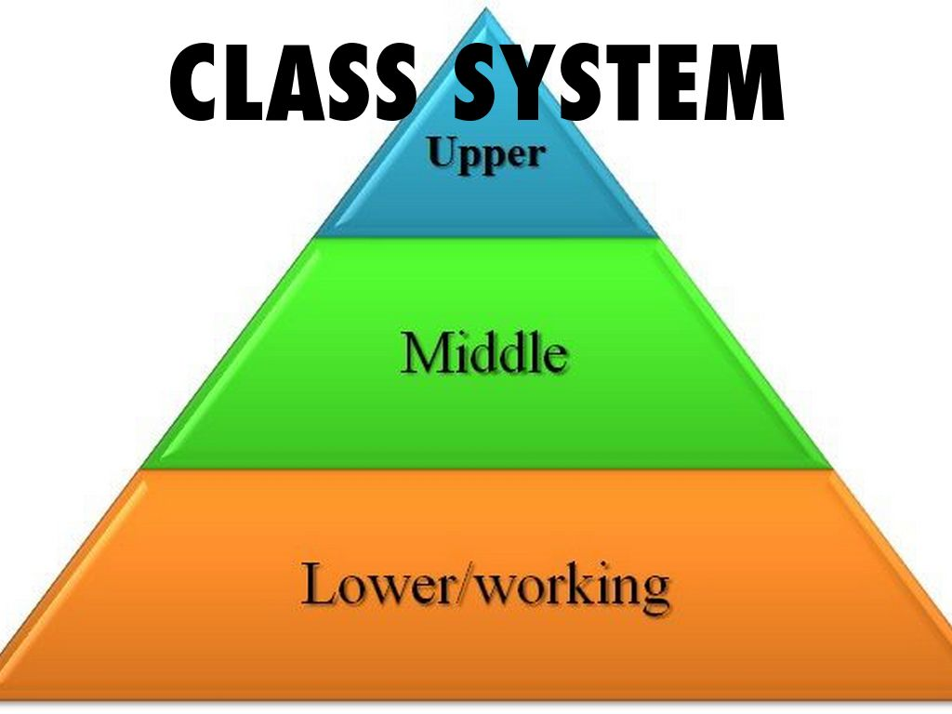
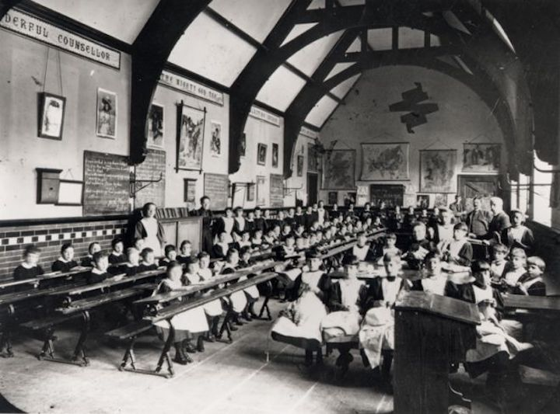
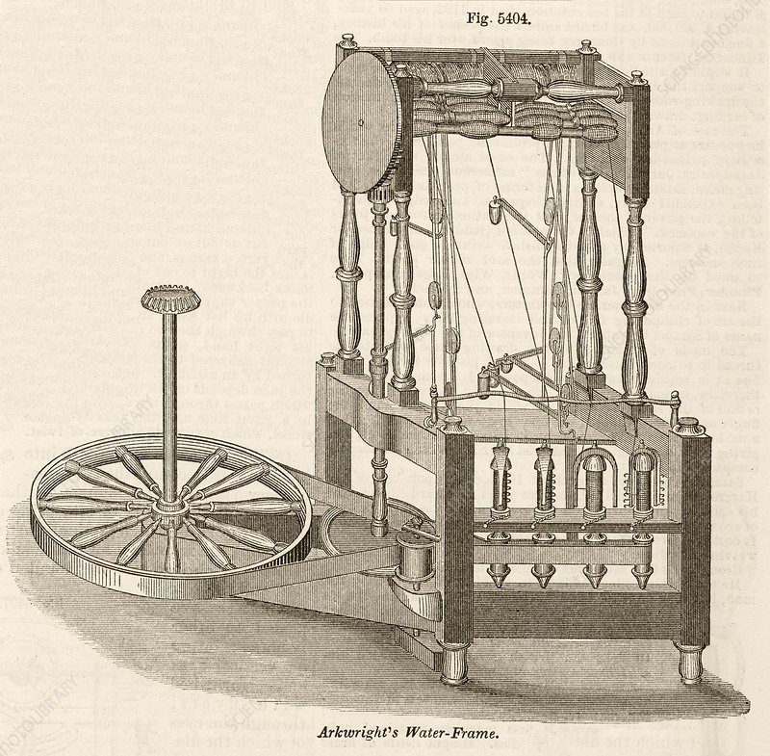
Industrial Revolution – Year 6
Things I should already know
British history prior to 1750s and how people’s lives have shaped the nation.
How Britain has been influenced by the wider world.
Who has ruled during that time and how people lived
At the end of my learning I will know
What Britain was like prior to the Industrial Revolution
How Preston changed during the industrial revolution
Class systems in place during that time
How Richard Arkwright’s invention changed production
What schools were like and what it was like for children
Key Vocabulary
Industrial | Anything related to industry, which means the making of goods and services by factories and other businesses.
Revolution | A major, often sudden change in the way a country is governed or the way people live
Social Class | A measure of a person's status or position within society
Child Labour | Work that children are too young to perform or that – by its nature or circumstances – can be hazardous.
Invention | A device that has been created and changed our way of living
Changes | Alterations or transformations that occur in societies, cultures, political systems, or other aspects of the human experience over time.

