Slide 1
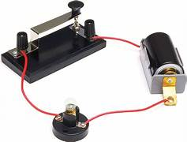
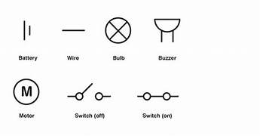
Electricity – Year 4
Things I should already know
Electricity can be very dangerous as you can get an electric shock from it. You need to be sensible around electrical devices.
Electricity lights things up eg. a light bulb.
At the end of my learning I will know
A series circuit is where the components are connected in a loop. Electricity flows through each component in a single pathway.
A complete circuit is where electricity can flow. The components will work
An incomplete circuit is where a break in the circuit that prevents the electricity from flowing. The components will not work.
Switches can be used to open or close a circuit. When off, a switch ‘breaks’ the circuit to stop the flow of electricity. When on, a switch ‘completes’ the circuit and allows the electricity to flow.
To produce light from a bulb, a complete electrical circuit must be formed by connecting a bulb,
Vocabulary
electricity | The flow of an electric current through a material, e.g. from a power source through wires to an appliance.
appliance | A piece of equipment or a device designed to perform a particular job, such as a washing machine or mobile phone.
battery | A device that stores electrical energy as a chemical. Two or more cells joined together form a battery.
circuit | A pathway that electricity can flow around. It is based around wires and a power supply. Examples of components (parts) you can add in to a circuit are bulbs, switches, buzzers and motors.

