Slide 1
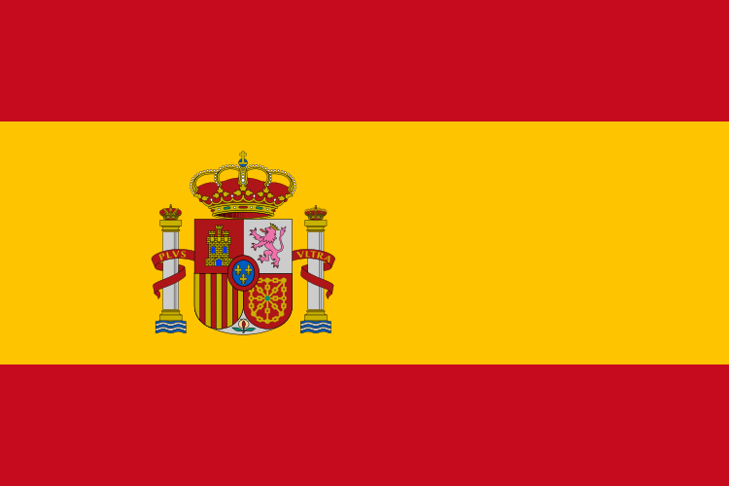
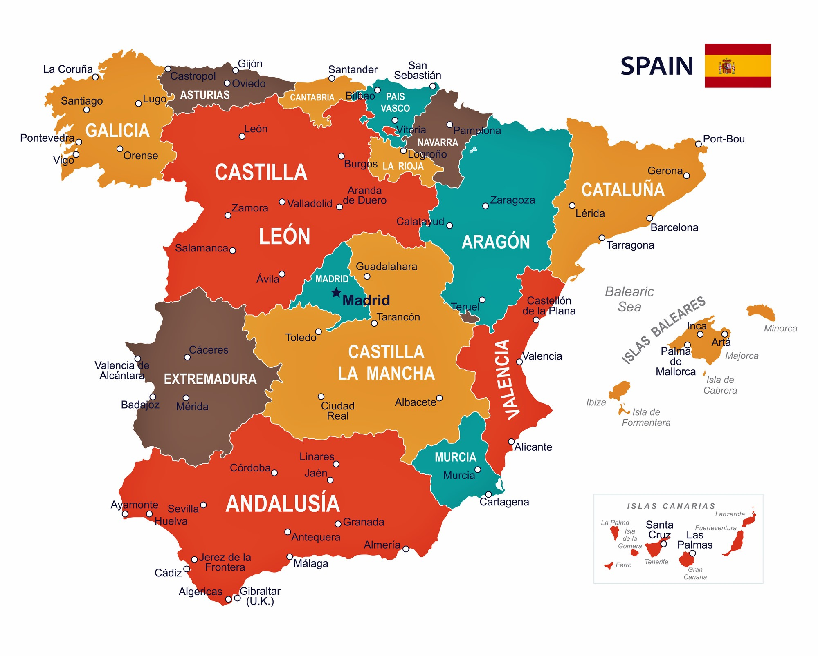
Spain(European Study) – Year 4
Things I should already know
Location of hot and cold places in relation to the equator and the North and South Pole.
Name and locate the seven continents and five oceans.
Use world maps, atlases and globes to identify continents and oceans.
Key Vocabulary
Tourism | The commercial organisation of holidays and visits to places of interest.
Climate | Climate is a pattern of weather that occurs over a long time such as years and centuries. For example, the climate in an area could be dry in that it rarely rains there.
Europe | One of the continents of the world.
Human geography | Human geography focuses on where people live, what they do, and how they use the land.
Physical geography | Physical geographers observe, measure, and describe Earth’s surface.
Population | The whole number of people living in a country, city, or area.
At the end of my learning I will know
Spain is in Europe and has a hot climate.
Geographical similarities and differences through the study of human and physical geography of a region in a European country (Spain)
Know about Human geography, including types of settlement and land use.
Know how location and climate influence economic activity.

