Slide 1
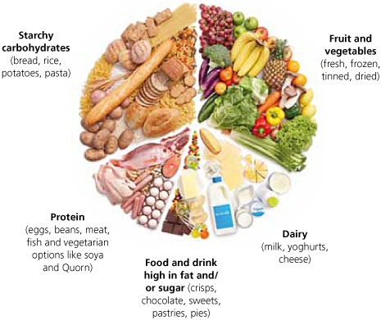
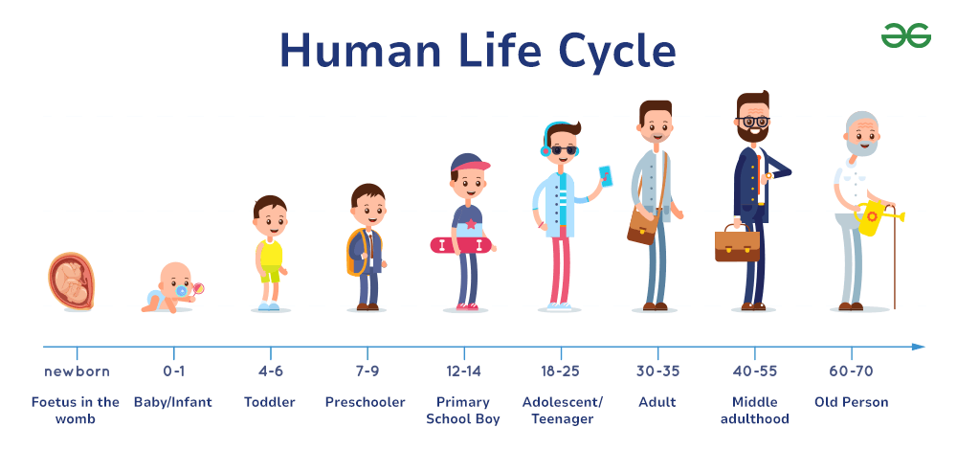
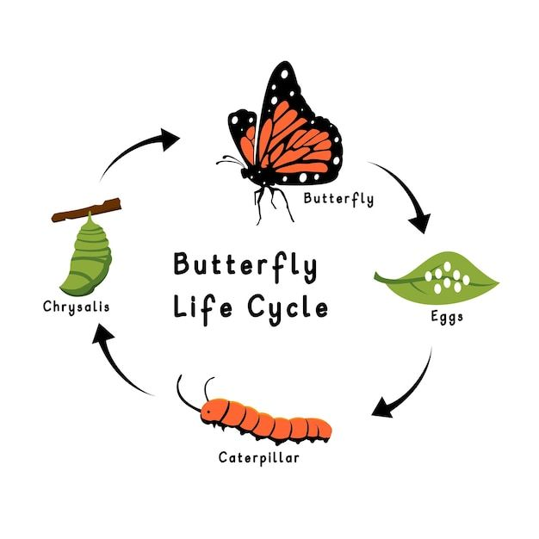
Animals, including humans – Year 2
Things I should already know
That there are a variety of common animals including fish, amphibians, reptiles, birds and mammals
That animals can be carnivores, herbivores and omnivores
Know the structure of a variety of animals
Know the basic parts of the human body which parts link to each sense
Vocabulary
Offspring | The young of an animal.
Carnivore | Animals that eats meat.
Herbivore | Animals that eats plants.
Omnivore | Animals that eat meat and plants.
Hygiene | Keeping clean to stay healthy and prevent disease.
Balanced diet | Eating a variety of different foods.
Life cycle | The changes living things go through to become adults.
At the end of my learning I will know
That animals, including humans, have offspring which grow into adults
That animals, including humans, have basic needs for survival
That it is important for humans to exercise, eat the right amounts of different types of food, and have good hygiene

