Slide 1
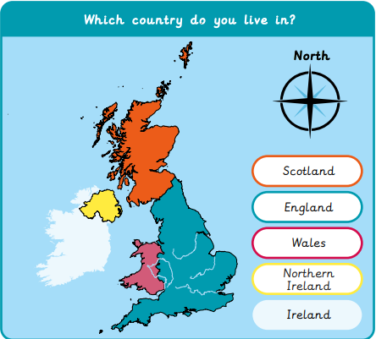
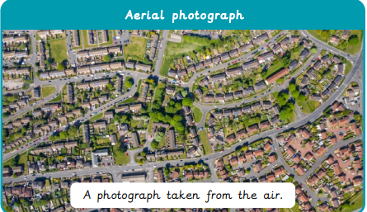
Our School– Year 1
Things I should already know
I go to Ingol Community Primary School
Ingol is located in the city of Preston.
I live in England.
Word | Meaning
Aerial view | A view of something from above as a bird would see it
City | A place where many people live closely together
Compass | A too that helps you find directions including North, South, East and West
Map | A picture or drawing of an area
Symbol | An object or image that represents something else
Plan | A map of an area or room
At the end of my learning I will:
Use simple fieldwork and observational skills to study the geography of our school and its grounds
Identify the key human and physical features of its surrounding environment.
Use simple compass directions (North, South, East and West) to describe the location and features on a map.

