Slide 1
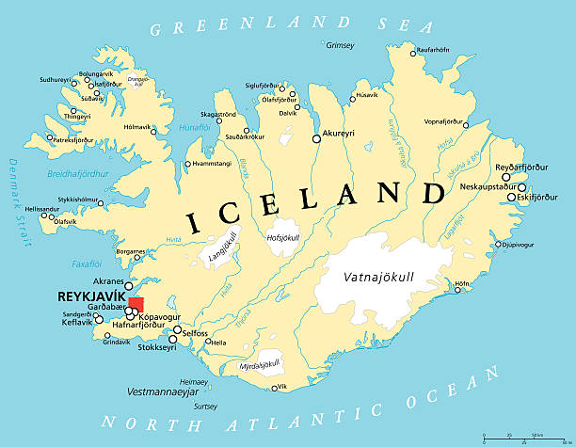
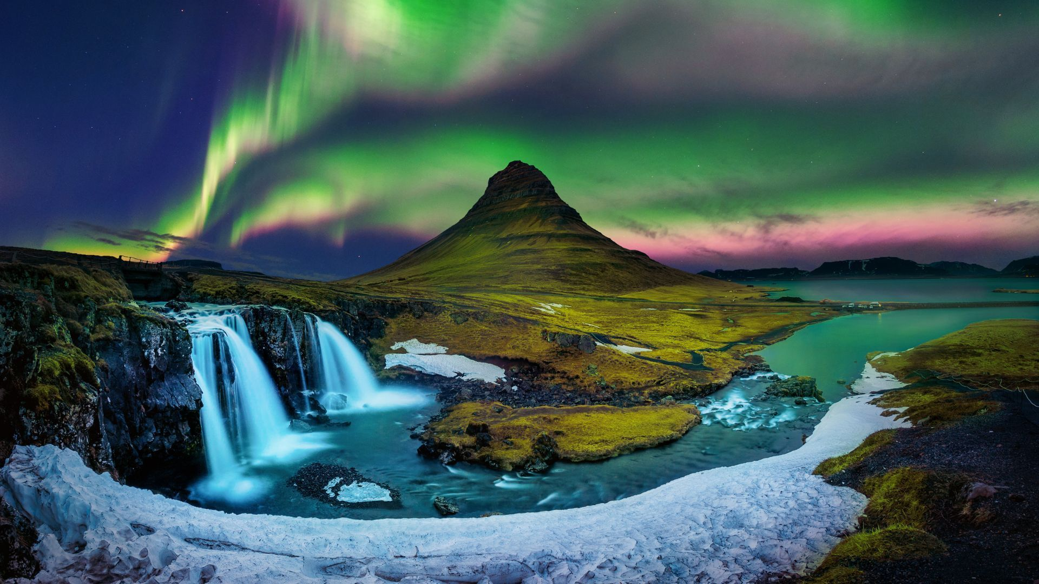
Iceland – Year 5
Things I should already know
How to use maps, atlases and globes to locate the world’s continents and countries.
Understand the meaning of human and physical characteristics in Geography.
Identify the capital cities for the UK countries
Identify the world’s oceans.
Know that places can be hot or cold depending on their proximity to the equator.
That the earth is made up of different layers.
How tectonic plates can cause earthquakes and volcanoes.
Key Vocabulary
Equator | an imaginary line around the middle of the Earth, that divides it into the top half (Northern Hemisphere and Southern Hemisphere). It's the hottest part of Earth
Physical Geography | Created by nature, not humans some examples are - mountains, rivers, oceans, deserts, volcanoes.
Human Geography | Things made by people and how they interact on earth, for example- cities, roads, bridges, agriculture, mining, politics.
Arctic Circle | An imaginary line around the top of the earth marking the start of the arctic regions, where temperatures are very cold and daylight hours are extreme.
Tectonic plates | The Earth’s surface broken into large chunks that can move slowly to create mountains, volcanoes and earthquakes.
Geothermal | Heat from within the earth it comes to the surface of the earth through volcanoes, hot springs and geysers. It can be turned into energy.
Glacier | A slow-moving river of ice, rock and dirt, that are formed through compacted snowfall. They are the largest source of fresh water on Earth.
Fissure | A long, narrow crack, split or opening in the ground that can be very deep. Sometimes, depending on location, lava will spill out of a fissure.
At the end of my learning I will know
The location of Iceland in relation to the equator and the Arctic circle.
How Iceland is split into regions and each region’s physical and human features.
Land use in Iceland
Identify the elevations and how they are visible on a map.
Study the climate of Iceland and make connections with Iceland’s location.
Identify the natural phenomena of Iceland.
Compare Iceland to England.
Think or reasons why Iceland is popular for tourists.

