Slide 1

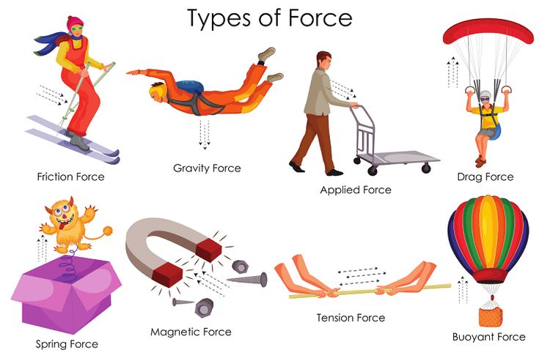
Forces – Year 5
At the end of my learning, I will know
that unsupported objects fall towards the Earth because of the force of gravity acting between the Earth and the falling object
identify the effects of air resistance, water resistance and friction, that act between moving surfaces
Recognise that some mechanisms, including levers, pulleys and gears, allow a smaller force to have a greater effect.
Vocabulary
Friction | A force that happens when two things rub together, making it harder for them to move or slide.
Gravity | An invisible pulling force than pulls things down to Earth and allows planets to stay orbiting in space.
Attract | An invisible force that pulls things together or towards each other, like magnets attract certain metals. It is the opposite of repel.
Repel | An invisible force that pushes things apart or away from each other. It is the opposite of Attract.
Newtons | The unit used to measure force (N). Named after Sir Isaac Newton who studied gravity and how things move.
Force Meter | A scientific tool used to measure the strength of a push or a pull acting on an object. Also called a Newton meter or a spring balance.
Upthrust | An invisible upward push from liquids or gases, that helps things float. For example, a boat on water or a balloon in the air.
Things I should already know
That things move differently on different surfaces due to the amount of friction.
Some forces need contact between two surfaces.
Magnetic force can act at a distance.
Magnets have two poles that attract and repel.
Magnets attract some materials but not others.

