Slide 1
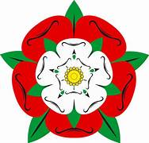
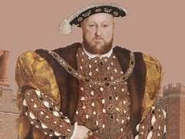
The Tudors – Year 4
Things I should already know
Know some British Monarchs
Queen Elizabeth I is from the Tudor family.
At the end of my learning I will know
The Tudors reigned from 1485 – 1603.
When Henry VII died, his son, Henry VIII became King.
Henry VIII formed the Church of England, separating it from the Roman Catholic Church.
Henry VIII had 6 wives.
When Henry VIII died. His son, Edward VI became King at aged 9 years old.
Elizabeth I was the daughter of Henry VIII. She reigned for nearly 45 years and led the English navy to defeat the Spanish Armada. She never married or had any children so when she died, the Tudor era ended.
The Houses of Lancaster/York united after the War of the Roses.
Vocabulary
Heir | A person who will inherit the throne when the current King or Queen dies.
Monarch | A person who rules over a place, usually a king or queen.
Throne | The position of a king or queen.
reign | To rule over a country as a monarch.
Divorce | The legal ending of a marriage.

