Slide 1
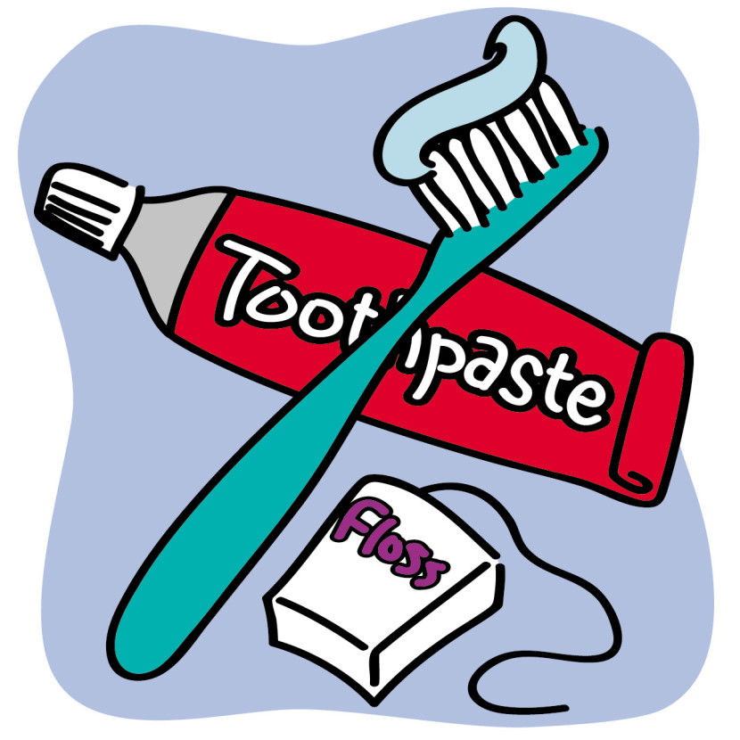
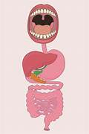
Digestive System/Teeth – Year 4
Things I should already know
How to brush our teeth.
Have a healthy diet.
Vocabulary
Digest | Break down food so it can be used by the body.
Oesophagus | A muscular tube which moves food from the mouth to the stomach.
Stomach | An organ in the digestive system where food is broken down with stomach acid and by being churned around.
Small Intestine | Part of the intestine where nutrients are absorbed into the body.
Large Intestine | Part of the intestine where water is absorbed from remaining waste food. Faeces are formed in the large intestine.
Teeth | Hard structures in the mouth that help with biting and chewing food.
At the end of my learning I will know
The key parts in the digestive system.
How we digest food.
The different types of teeth ad their functions in both humans and animals.
How to prevent tooth decay.

