Slide 1
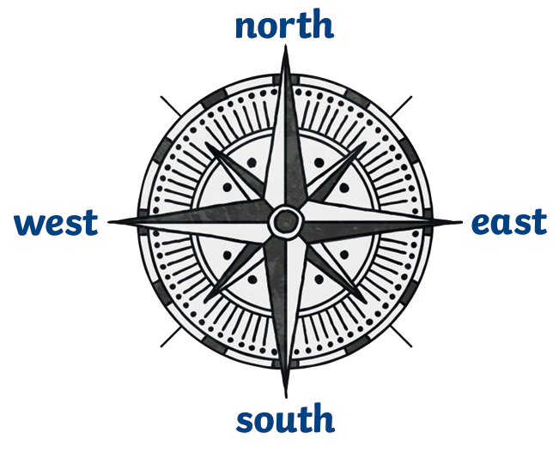

Map Skills – Year 2
Things I should already know
Why people need to use maps.
The compass points North, South, East and West.
Different types of maps such as a globe, atlas and online map.
How to draw a simple map of a familiar place such as the school playground.
Our city is called Preston.
Word | Meaning
Map | A drawing of a real place to help people find their way around.
Symbol | A picture on a map to represent something else.
Key | Explains what the symbols on a map mean.
Compass rose | Printed on a map to show different directions.
Aerial | What a place looks like from above.
At the end of my learning I will:
Know what Human Geography is.
Know what Physical Geography is.
Identify common map symbols and explain why they are used.
Be able to draw and label a map of our local community using symbols, positional and directional language.
Identify local landmarks from aerial photographs.
Match national landmarks to an aerial photograph.

