Slide 1
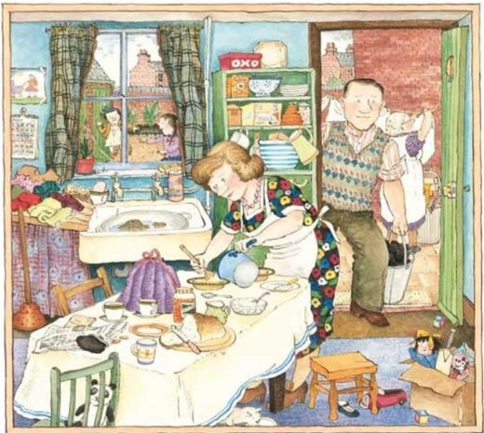
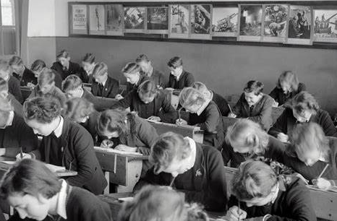
Events from Living Memory – Year 2
Things I should already know
History is the study of things that have happened in the past
We learn about the past from sources such as diaries, stories, photographs and objects
How my life has changed since I was a baby
The chronology of my family – grandparents, parents and me.
The world has changed over the course of history
Word | Meaning
Childhood | The time between being a toddler and a teenager.
Compare | Look at two or more things and state what is different.
Analyse | To carefully study something.
Evidence | Clues that tell us about the past.
Predictions | A sensible guess based on evidence.
At the end of my learning, I will:
Analyse different sources of evidence
Ask questions based on sources of evidence
Make predictions based on sources of evidence
Compare and contrast my childhood to that of my parents and grandparents
Explain how the family home has changed in the last 60 years and give my opinion
Explain how education has changed and give my opinion

