Slide 1
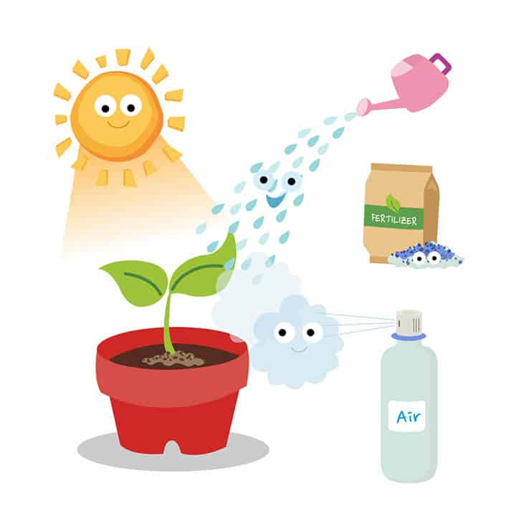
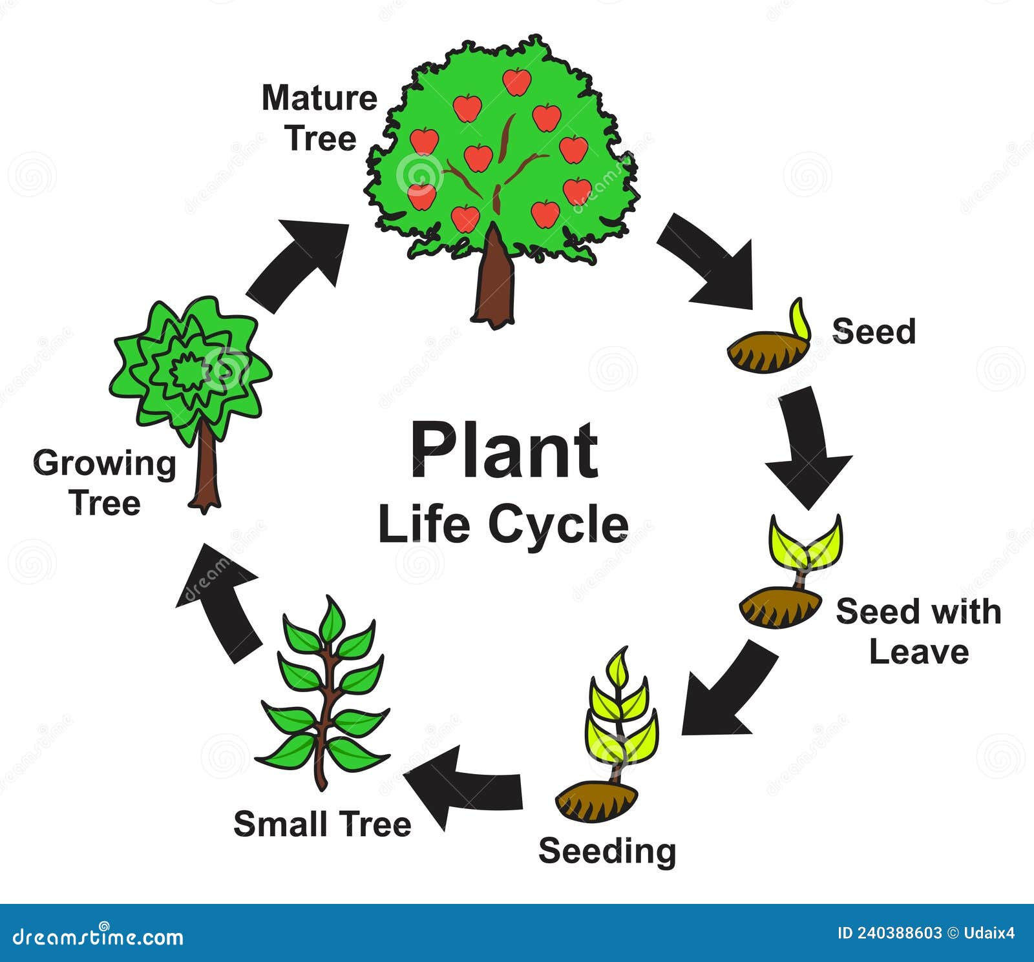
Plants – Year 2
Things I should already know
The name of a variety of common wild and garden plants, including deciduous and evergreen trees
To be able to identify and describe the basic structure of a variety of common flowering plants, including trees.
Fair test
Healthy plants
At the end of my learning, I will know
How seeds and bulbs grow into mature plants
How plants need water, light and a suitable temperature to grow and stay healthy
Vocabulary
Reproduction of plants | Making offspring of plants.
Temperature | How hot or cold something is and knowing what the right temperature is for something to grow.
Growth | The increasing development of the plant.
Germination | The process of changing from a seed into a seedling .

