Slide 1
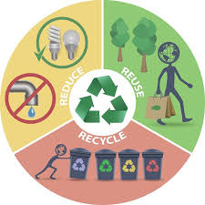
Environment – Year 4
Things I should already know
Our planet provides everything that we and all living things need. We call it our environment.
Some animals are endangered and can become extinct.
Key Vocabulary
Recycle | Turning the rubbish in to something else instead of throwing it away.
Reduce | Make less rubbish and use less energy.
Re-Use | Using things again or finding a new use for your rubbish instead of throwing it away.
Pollution | Introduction of harmful substances to the natural environment.
Sustainability | Using resources responsibly today, so they are available for future generations.
Environmentally Friendly | Not harmful to the environment.
Solar Energy | The light and heat from the sun that we can use as a source of power.
Carbon Emission | The release of carbon into the atmosphere which contributes to global warming and climate change.
At the end of my learning I will know
Climate change is a change in the overall weather and temperature on Earth. (Not the day-to-day weather). The Earth is getting warmer due to some of the things humans are doing. This means it will be more difficult for livings things to survive.
The choices that we make can effect the environment and climate change.
Different ways to save resources and improve our environment.

