Slide 1
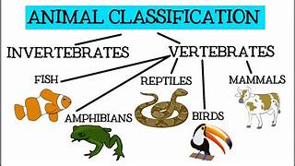
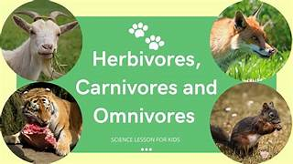
Mammals,
Living Things and their Habitats–Year 4
Things I should already know
Recognise living things and their habitats.
Know that some animals eat meat (carnivores) some eat plants (herbivores) and some eat both.(omnivores)
Vocabulary
Habitat. | A habitat is the specific area or place in which particular animals or plants may livH
Endangered Species | An endangered species is a species that is at risk of extinction.
Classification | Classification is the process of grouping living things according to their similarities.
Vertebrates | animals have a spine (also known as a backbone). The spine helps to hold the body upright, protects the spinal column and allows the body to move.
Invertebrates | Do not have a spine.
Cold-blooded | ‘Cold-blooded’ refers to animals that are not able to generate their own body heat.
At the end of my learning I will know
Vertebrates can be sorted into five main groups with their own characteristics eg. mammals, birds, reptiles, amphibians and fish.
Invertebrates can be sorted into many different groups. Here are four of them eg. arthropods, molluscs, Annelids and Echinoderms.

