Slide 1
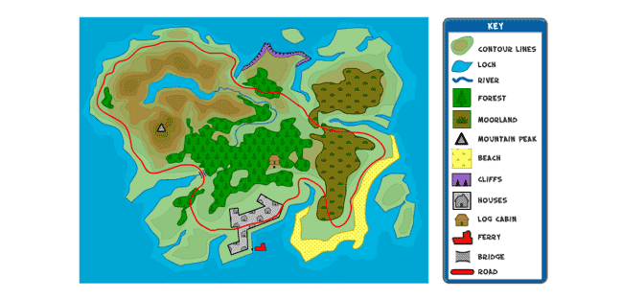
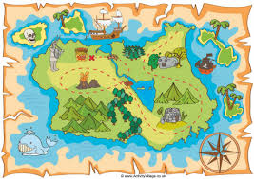
Island Homes – Year 1
Things I should already know:
How to read a simple map
How to read directions on a compass
Word | Meaning
Island | A piece of land surrounded by water
Map | A picture or drawing of an area
Globe | A 3-D model of the Earth
Symbol | An image that represents something else
Feature | An aspect of something
Coast | Where the land meets the sea
Environment | The surroundings of an area
Isolated | An island cut off from the mainland
Deserted | An island with no people
At the end of my learning I will:
Be able to describe and use symbols on a map to represent features of an island.
Understand that the UK is a group of islands and be able to locate England, Scotland, Wales and Northern Ireland on a map.
Be able to write a fact file about island life.

