Slide 1
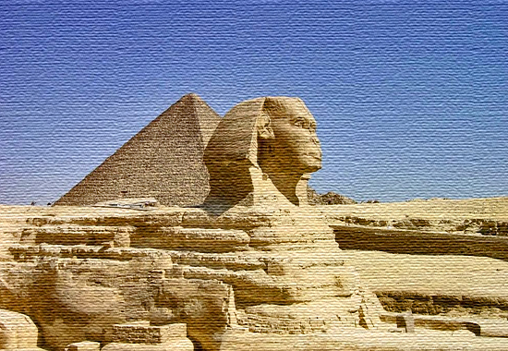
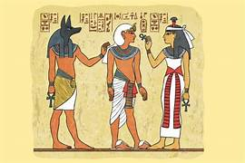
Ancient Egypt – Year 4
Things I should already know
Ancient is something from a very long time ago.
Egypt is in North Africa.
At the end of my learning I will know
The ancient Egyptians built the pyramids as resting places for the pharaohs.
When a pharaoh died, priests would prepare their bodies with a process called mummification.
Pharaohs were placed in a tomb, often under a pyramid, with their most treasured possessions. The ancient Egyptians believed that these treasures would help them in the afterlife.
The Nile was used for water, fishing and trade. Mud from the river banks was used to make bricks and papyrus plants were used to make paper.
Tutankhamun was a pharaoh known more recently as the ‘boy king’ because he became pharaoh when he was 9 years old.
His tomb was discovered by Howard Carter and his team in the Valley of the Kings in 1922
Vocabulary
Civilisation | A human society with well-developed rules and government, often where technology and the arts are considered important.
hieroglyphics | A system of writing that consists of pictures and symbols (hieroglyphs) instead of letters.
Pharaoh | A ruler of ancient Egypt.
Tomb | A sealed room where a person was placed after death.
The Nile | A river that runs through Egypt. It was essential to life in ancient Egypt.

