Slide 1
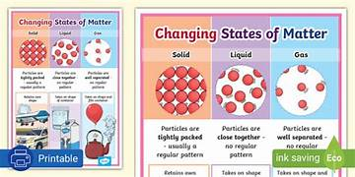
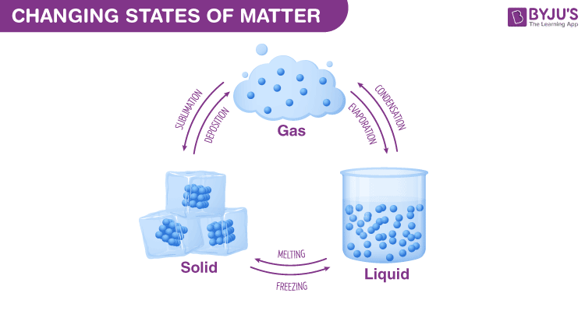
Mammals,
States of Matter–Year 4
Things I should already know
Some materials can change shape when you squash, bend, twist or stretch them. Materials that are soft, bendy or stretchy are often easier to change the shape of than materials that are hard, rigid or strong.
The properties of a material affect their suitability, making them either suitable or unsuitable for particular uses.
Vocabulary
Solids | Solids are materials that keep their shape unless a force is applied to them. They can be hard, soft or even squashy. Solids take up the same amount of space no matter what has happened to them.
Liquids | Liquids take the shape of their container. They can change shape but do not change the amount of space they take up. They can flow or be poured.
Gases | Gases can spread out to completely fill the container or room they are in. They do not have any fixed shape but they do have a mass.
Particle | A particle is a small piece of matter that cannot be seen with the naked eye.
States of Matter | Materials can exist in any of three states: solids, liquids or gases. Some materials can change from one state to another and back again.
Melt | When a material melts, it changes from a solid into a liquid.
Freeze | When a material freezes, it changes from a liquid into a solid.
condense | When a material condenses, it changes from a gas into a liquid.
At the end of my learning I will know
Increasing the temperature of a solid can cause it to melt into a liquid and eventually evaporate the liquid into a gas.
Decreasing the temperature of a gas can condense it into a liquid and eventually freeze the liquid into a solid.

