Slide 1
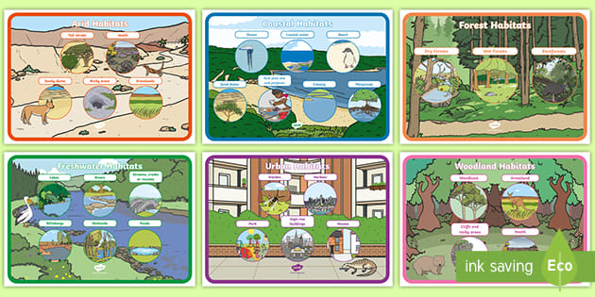
Living things and habitats – Year 2
Things I should already know
There is a variety of animals including fish, amphibians, reptiles, birds and mammals
Animals are carnivores, herbivores or omnivores
The structure of a variety of animals
The basic parts of the human body and say which part of the body is associated with each sense
At the end of my learning
I will explore and compare the differences between things that are living, dead, and things that have never been alive
Identify that most living things live in habitats to which they are suited
Understand the basic needs of different kinds of animals and plants, and how they depend on each other
Identify and name a variety of plants and animals in their habitats, including microhabitats
Describe how animals obtain their food and understand the idea of a simple food chain
Vocabulary
Reproduction of plants | Making offspring of plants
Temperature | How hot or cold something is and knowing what the right temperature is for something to grow
Growth | The increasing development of the plant
Germination | The process of changing from a seed into a seedling
Habitat | The place where plants and animals live
Microhabitat | A small habitat within a larger habitat where small creatures live

