Slide 1
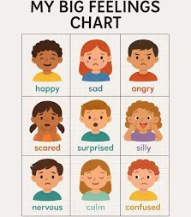
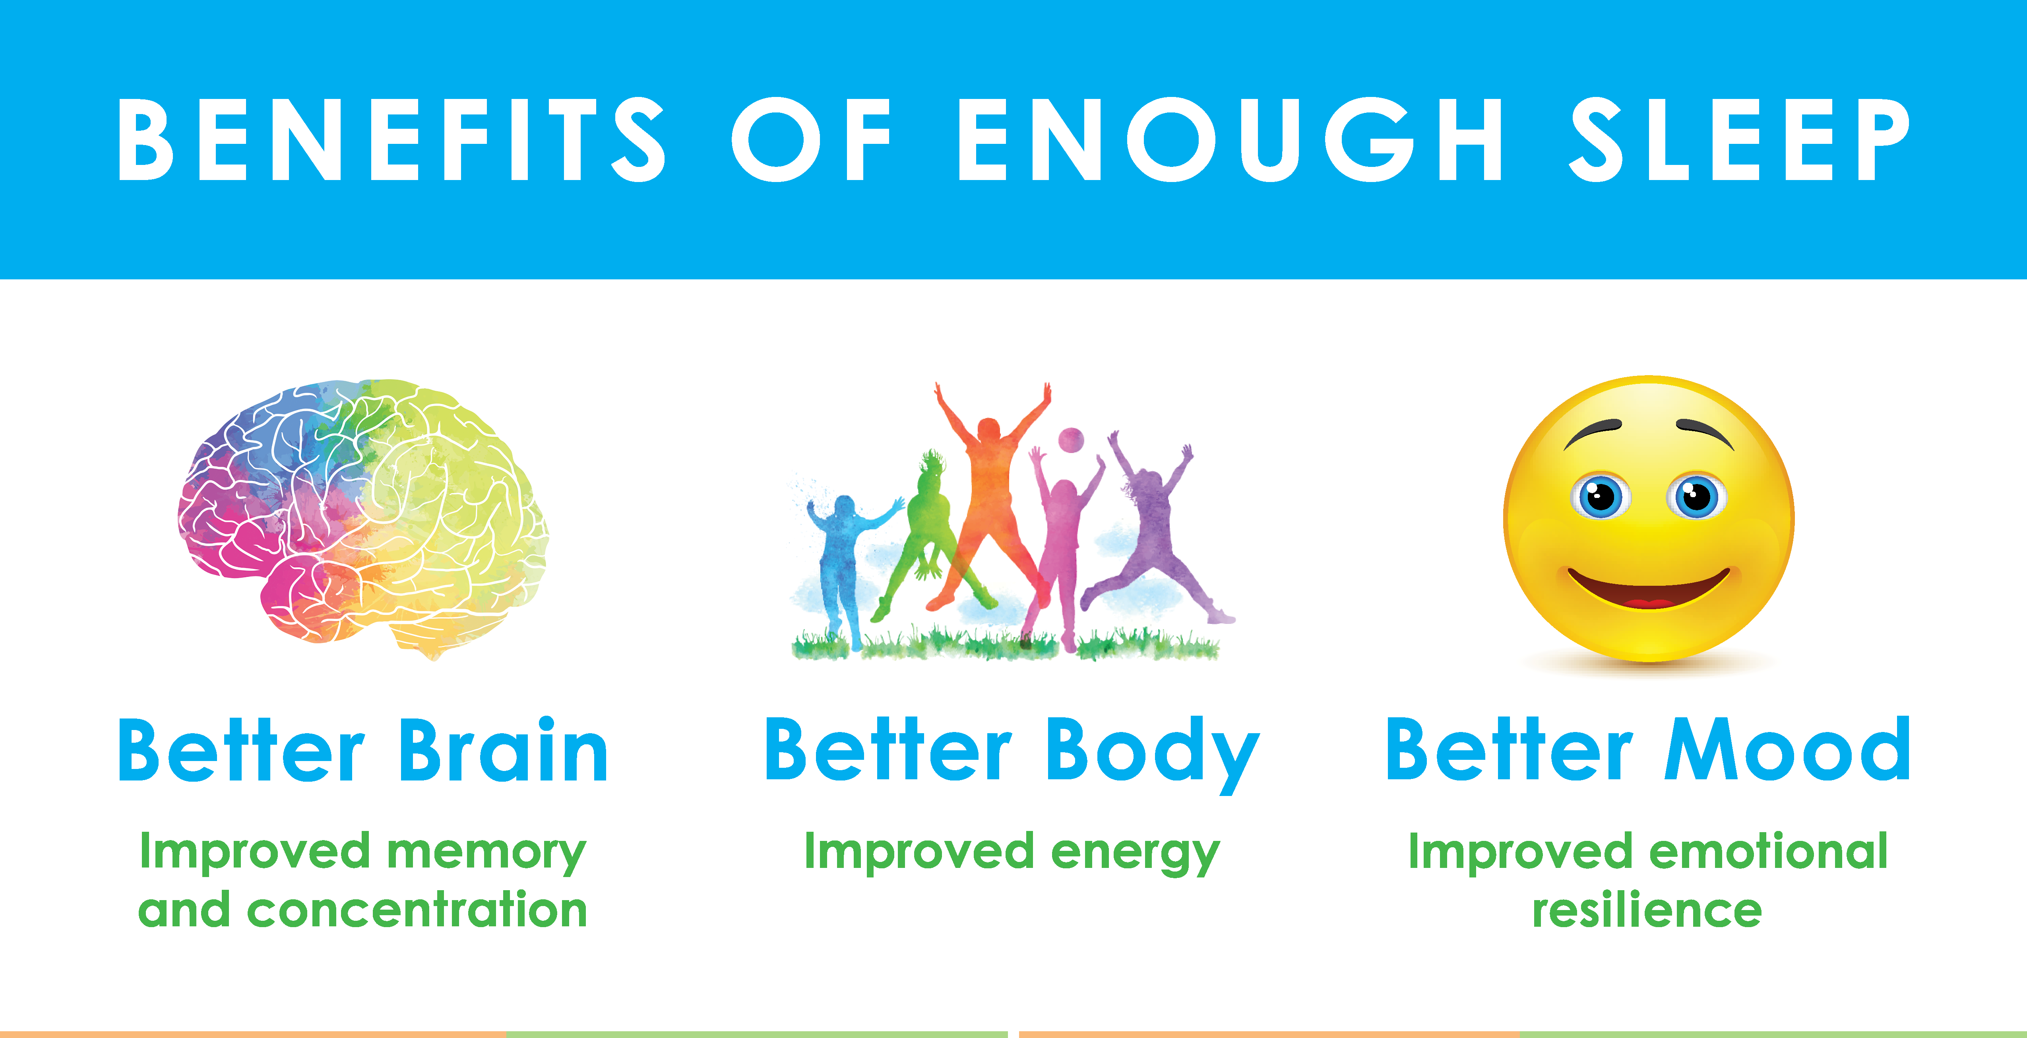
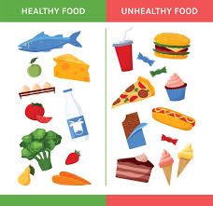
Health and Well Being – PSHE – Year 2
Things I should already know
What it means to be healthy and why it is important
Ways to take care of themselves on a daily basis
Basic hygiene routines
Differences between healthy and unhealthy foods
Recognise what makes them special and unique including their likes, dislikes and what they are good at
How to manage and whom to tell when finding things difficult, or when things go wrong
How they are the same and different to others
About different kinds of feelings
Rules in the school, home & community
Word | Meaning
Routine | Something that you do regularly – tasks or actions
Mental health | Affects how we think, feel and act and managing our emotions
Grief | The intense emotional response to losing someone we love
Goals | A particular target you are working to achieve
Mental health
Physical health
At the end of my learning, I will:
Understand about routines and habits needed for good physical and mental health
Understand why sleep and rest is important
Know that medicines, including vaccinations and immunisations, can help people stay healthy and manage allergies
Understand the importance of, and routines for, brushing teeth and visiting the dentist
Know about food and drink that affect dental health
Know how to describe and share a range of feelings
Know ways to feel good, calm down or change their mood e.g. playing outside, listening to music, spending time with others
Understand how to manage big feelings including those associated with change, loss and bereavement
Know when and how to ask for help, and how to help others, with their feelings
Stay calm
Brush your teeth
Talk to people

