Slide 1
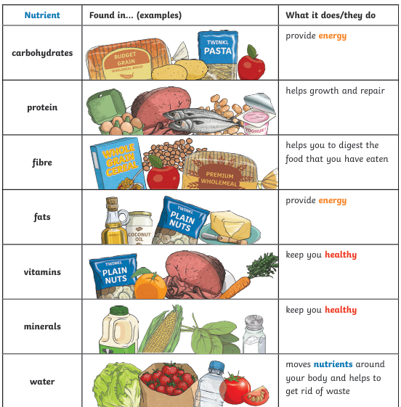
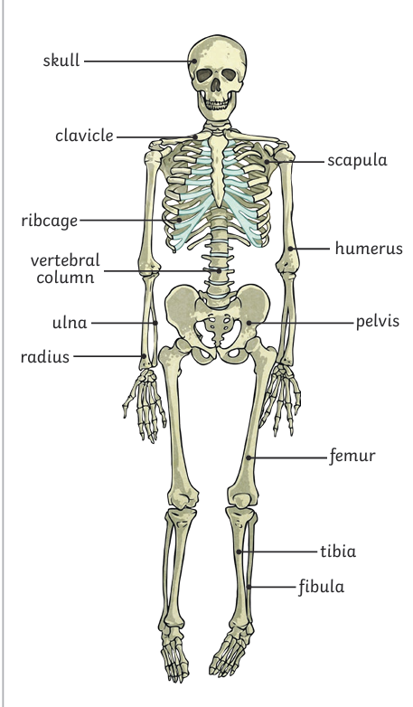
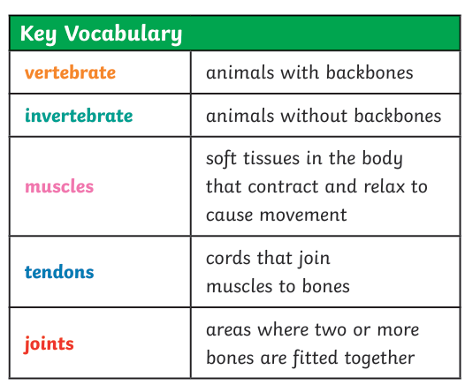
Animals including Humans– Year 3
Things I should already know
Living things need food to grow and to be strong and healthy.
• Plants can make their own food, but animals cannot.
• To stay healthy, humans need to exercise, eat a healthy diet and be hygienic.
• Animals, including humans, need food, water and air to stay alive.
At the end of my learning I will know
identify that animals, including humans, need the right types and amount of nutrition, and that they cannot make their own food; they get nutrition from what they eat
identify that humans and some other animals have skeletons and muscles for support, protection and movement

