Slide 1
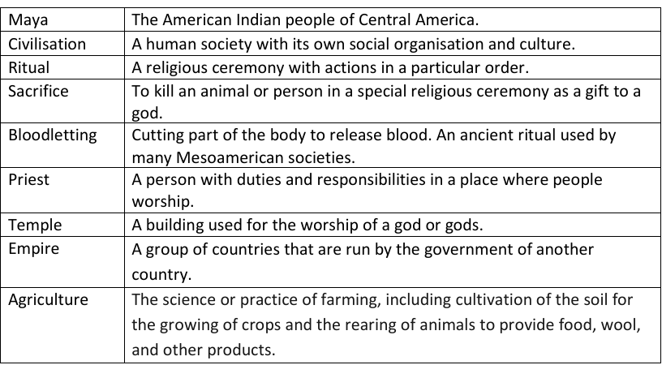
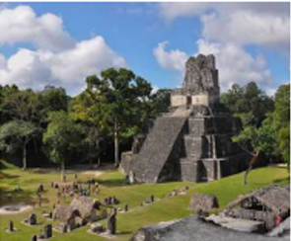
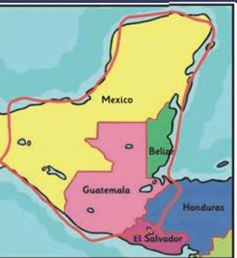
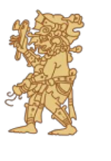
Ancient Maya– Year 3
Things I should already know
History is the study of things that have happened in the past
We learn about the past from sources such as diaries, stories, photographs and objects
We understand what chronological means and how it is an order in time
The world has changed over the course of history
Analyse different sources of evidence
Ask questions based on sources of evidence
Make predictions based on sources of evidence.
At the end of my learning, I will:
• To understand that there are differences between early and later civilisations.
• To know what life was like in the Ancient Maya civilisation.
• To be aware of the achievements of the Maya.
• To know that there are different theories for the decline of the Maya.
• To compare the Maya to the Anglo Saxons in Britain.
• To know how we know about the Maya.

