Slide 1
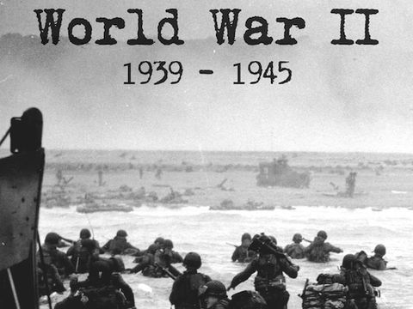
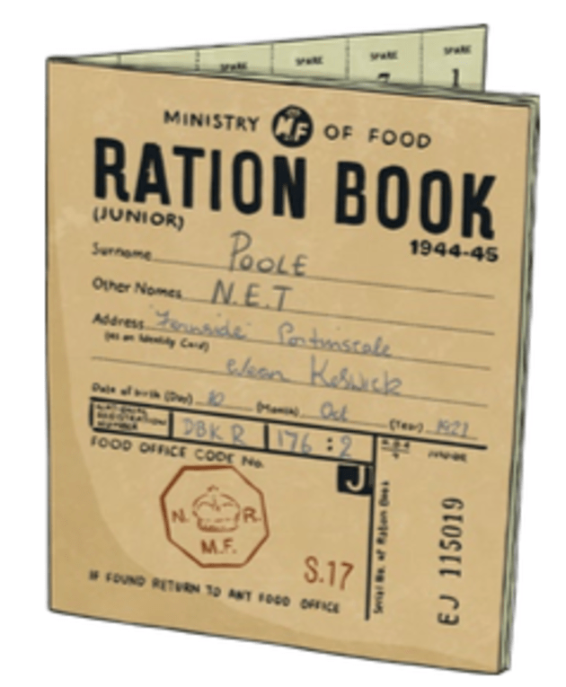

World War II – Year 6
Things I should already know
British history prior to 1750s and how people’s lives have shaped the nation.
How Britain has been influenced by the wider world.
Who has ruled during that time and how people lived
At the end of my learning I will know
How WWII broke out
How peoples' diets were different in WWII
Why evacuation was a huge turning point for children
What was GREAT (groundbreaking, remembered by all, events were far reaching, affecting the future, terrifying) about the Battle of Bamber Bridge
How propaganda affected the world
Key Vocabulary
War | A state of armed conflict between different countries or different groups within a country
Rationing | An amount of food supplied on a regular basis
Evacuation | To leave or withdraw from a place
Propaganda | A concerted set of messages aimed at influencing the opinions or behaviour of large numbers of people
Battle of Bamber Bridge | an outbreak of racial violence involving American soldiers stationed in the village of Bamber Bridge, Lancashire
Blitz | a bombing campaign by Nazi Germany and Fascist Italy against the United Kingdom during the Second World War.

