Slide 1
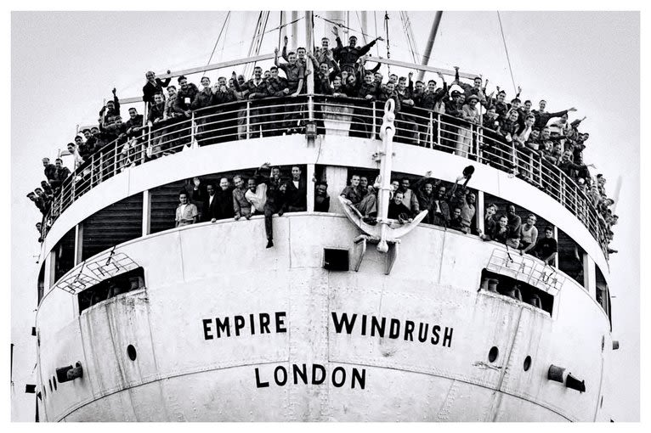
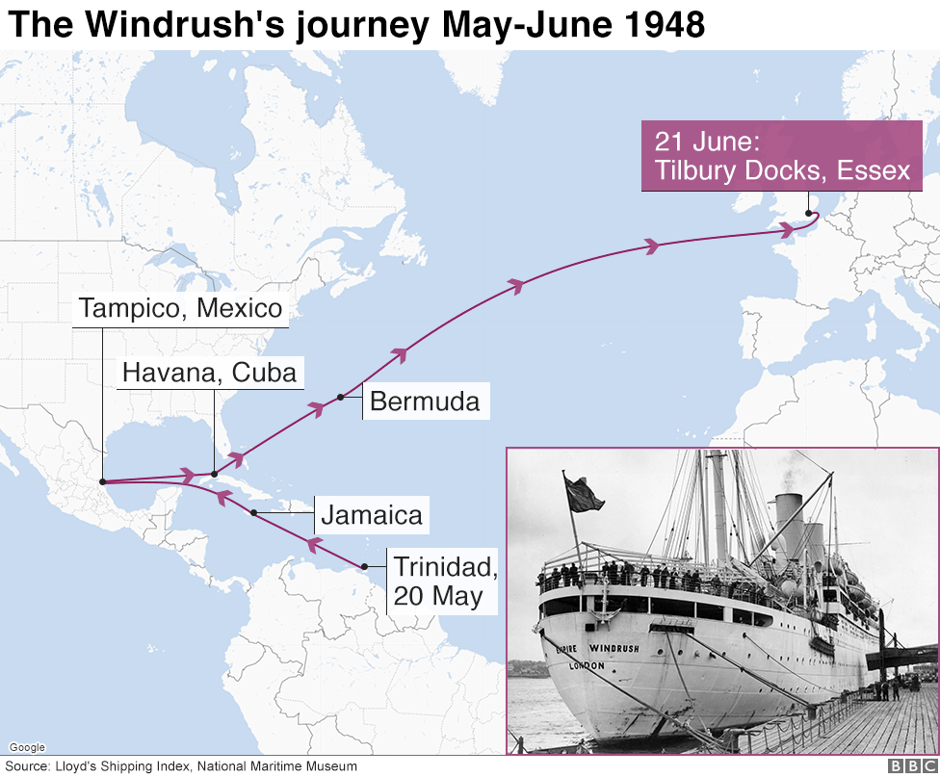
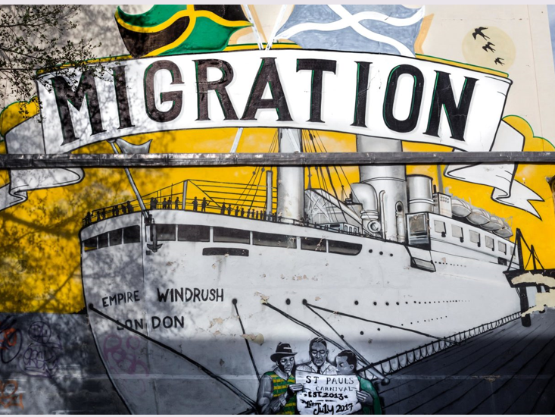
Windrush – Year 6
Things I should already know
British history prior to 1750s and how people’s lives have shaped the nation.
How Britain has been influenced by the wider world.
Who has ruled during that time and how people lived
At the end of my learning I will know
Why people wanted to immigrate to Britain
Who some of the passengers were on HMT Empire Windrush
Where the Windrush generation are today
Why the Windrush generation were important to society
How we should continue to celebrate Windrush
Key Vocabulary
Immigrate | To come into a forgein country to live there permanentely
HMT Empire Windrush | A British troopship famous for being one of the first large groups of Caribbean post-war immigrants to the UK.
Generation | A group of people born around the same time
Society | A structured groups of individuals sharing culture
Migration | The movement of people away from their habitual place of residence
Settlement | The process of settling in such a place

