Slide 1
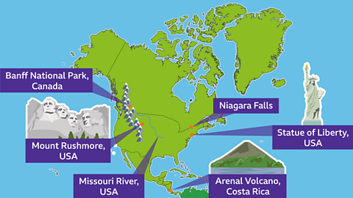
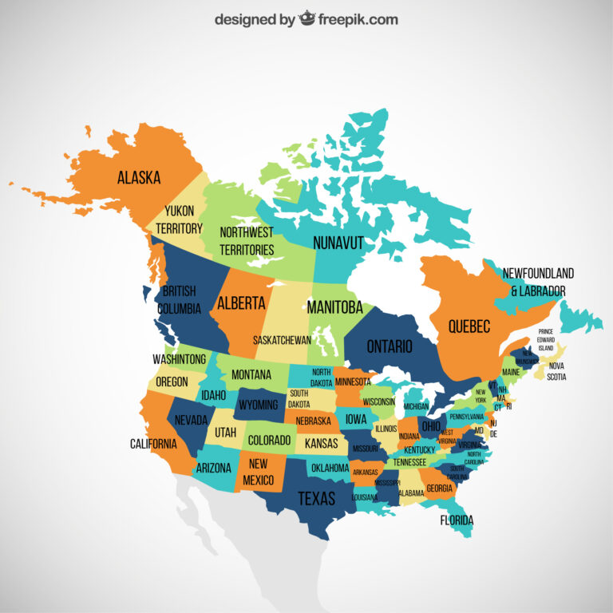
North America – Year 6
Things I should already know
Locate the world’s countries, using maps to focus on South America, concentrating on their environmental regions, key physical and human characteristics, countries, and major cities
Identify the position and significance of the Tropics of Cancer and Capricorn
Understand the position and significance of the equator, Northern and Southern Hemisphere, Arctic and Antarctic Circle, the Prime/Greenwich Meridian and time zones (including night and day)
Key Vocabulary
Longitude | We use lines of longitude to find out how far east or west a place is. These lines run from the top of the Earth to the bottom.
Latitude | We use lines of latitude to find out how far north or south a place is. These lines run parallel to the Equator.
Arctic circle | The Arctic Circle surrounds the North Pole at 66.5°N
Antarctic circle | the Antarctic Circle surrounds the South Pole at 66.5°S.
Cities | a city is larger than a town – usually with a population of over 100,000 people. Cities are also home to a wealth of shops and services such as schools, universities, hospitals, offices, and often a cathedral.
Capital cities | a city where the government of that country is based.
Government | a group of people with the authority to run a country, state, or community
Landmarks | features or structures around the world that are easily recognised or unique. They can be natural or man-made.
At the end of my learning I will know
Locate the world’s countries, using maps to focus on North America, concentrating on their environmental regions, key physical and human characteristics, countries, and major cities
Identify the position and significance of Longitude & latitude, the Prime/Greenwich Meridian and time zones (including day and night)
Understand geographical similarities and differences through the study of human and physical geography of a region within North America

