Slide 1
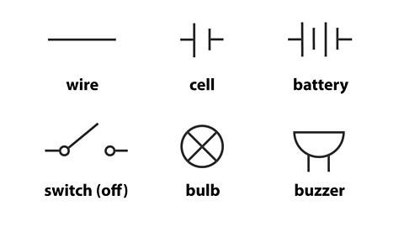
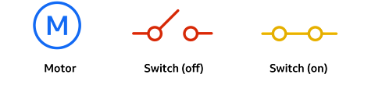
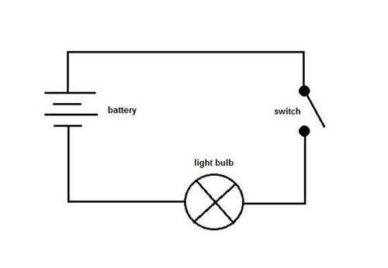
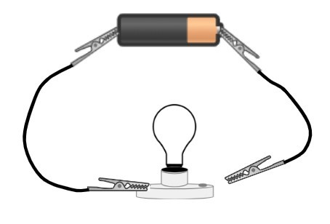
Electricity – Year 6
Things I should already know
Identify common appliances that run on electricity construct a simple series electrical circuit, identifying and naming its basic parts, including cells, wires, bulbs, switches and buzzers
Identify whether or not a lamp will light in a simple series circuit, based on whether or not the lamp is part of a complete loop with a battery
Recognise that a switch opens and closes a circuit and associate this with whether or not a lamp lights in a simple series circuit
Recognise some common conductors and insulators, and associate metals with being good conductors.
Key Vocabulary
Circuit | Circuit contains a power source and devices, which are connected together in a loop using wires.
Complete Circuit | A circuit where a switch is closed to allow electricity to pass through it.
Circuit Diagram | A technical drawing that is used to show all of the different components that are used and where they are in electrical systems
Circuit symbol | a simple picture that is used to represent an electrical component when drawing a circuit diagram.
Cell | A power source
Battery | A power source made from more than one cell.
Bulb | Electrical energy is converted into light energy and heat energy.
Motor | This is a device that spins when current flows through it. Motors are used in fans, food processors and many other devices.
Switch | Circuits in real life almost always contain a switch so they can be turned on and off when needed.
Voltage | A measurement of the strength of an electric current. Circuits with lots of components need more voltage.
At the end of my learning I will know
Associate the brightness of a lamp or the volume of a buzzer with the number and voltage of cells used in the circuit
Compare and give reasons for variations in how components function, including the brightness of bulbs, the loudness of buzzers and the on/off position of switches
Use recognised symbols when representing a simple circuit in a diagram.

