Slide 1
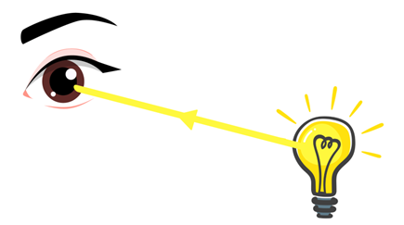
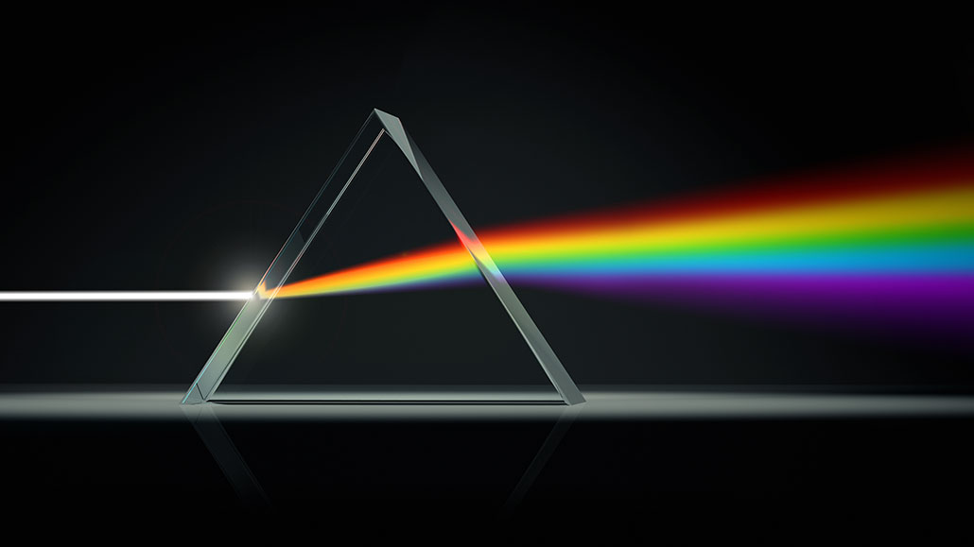
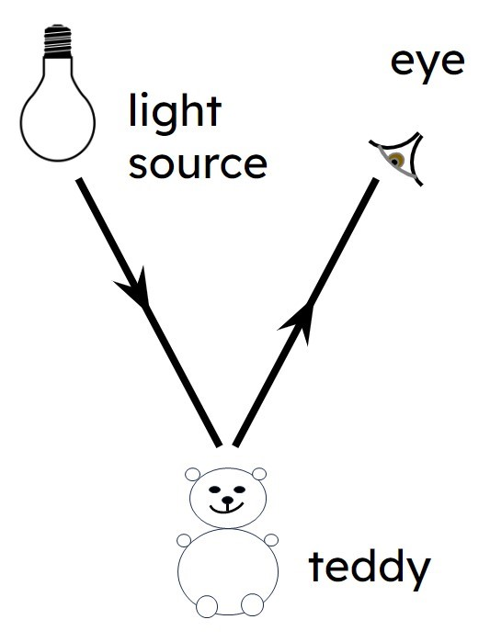
Light – Year 6
Things I should already know
recognise that they need light in order to see things and that dark is the absence of light
notice that light is reflected from surfaces
recognise that light from the sun can be dangerous and that there are ways to protect their eyes
find patterns in the way that the size of shadows changes
recognise that shadows are formed when the light from a light source is blocked by a solid object
Key Vocabulary
Light source | any object or phenomenon that emits light energy
Absence of light | darkness, a physical condition resulting from a lack of illumination
Surface | the outermost, top, or boundary layer of a physical object, liquid, or area
Shadow | a dark, two-dimensional shape or area cast upon a surface when an object intercepts light rays
Reflect | to throw back light, heat, or sound from a surface, to mirror an image, or to think seriously and carefully
Mirror | a reflective surface, typically glass coated with metal, that produces an image of whatever is in front of it.
Light rays | narrow, straight-line paths of light energy, commonly modeled in physics as lines drawn at 90-degree angles to light waves
Straight lines | a one-dimensional, infinitely long path that has no curves, bends, or thickness
Sunlight | the light and radiation that comes directly from the sun
At the end of my learning I will know
recognise that light appears to travel in straight lines
use the idea that light travels in straight lines to explain that objects are seen because they give out or reflect light into the eye
Use the idea that light travels in straight lines to explain why shadows have the same shape as the objects that cast them.
explain that we see things because light travels from light sources to our eyes or from light sources to objects and then to our eyes

