Slide 1
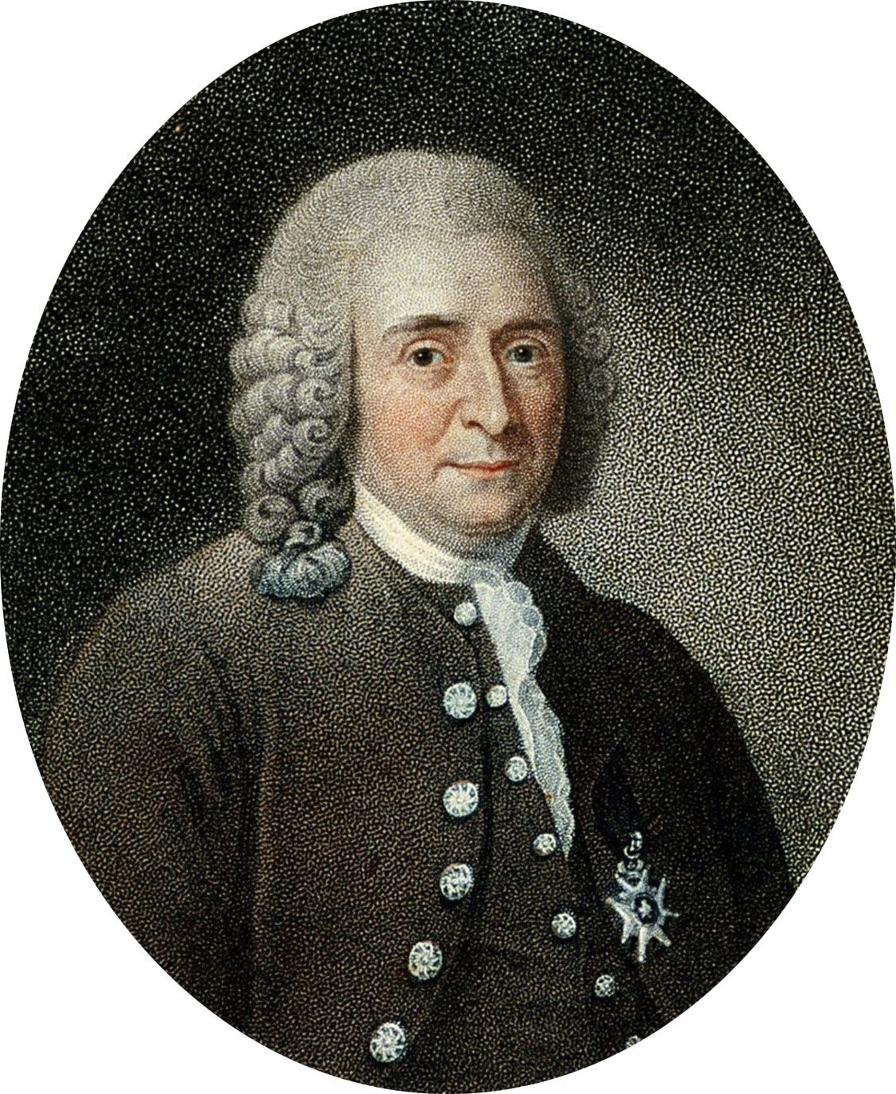
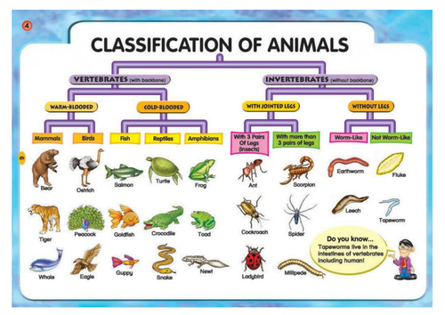
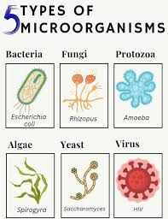
Living things and Habitats – Year 6
Things I should already know
Describe the differences in the life cycles of a mammal, an amphibian, an insect and a bird
Describe the life process of reproduction in some plants and animals.
Key Vocabulary
Vertebrates | Animals that have a backbone inside their body. The major groups include fish, amphibians, reptiles, birds and mammals.
Invertebrates | Animals that don't have a backbone. They either have a soft body, like worms and jellyfish, or a hard outer casing covering their body, like spiders and crabs.
Warm-blooded | Animals, also known as endothermic, regulate their body temperature by generating their own heat internally.
Cold-blooded | Animals, also known as ectothermic, rely on external sources to control their core temperate. They may bask in the sun or seek shade, for example. They cannot generate their own heat or cool themselves down.
Flowering | A plant that produces flowers, and these flowers turn into fruits.
Non-flowering | A plant that does not produce flowers, fruits, or seeds to reproduce
At the end of my learning I will know
Describe how living things are classified into broad groups according to common observable characteristics and based on similarities and differences, including micro-organisms, plants and animals
Give reasons for classifying plants and animals based on specific characteristics.

