Slide 1
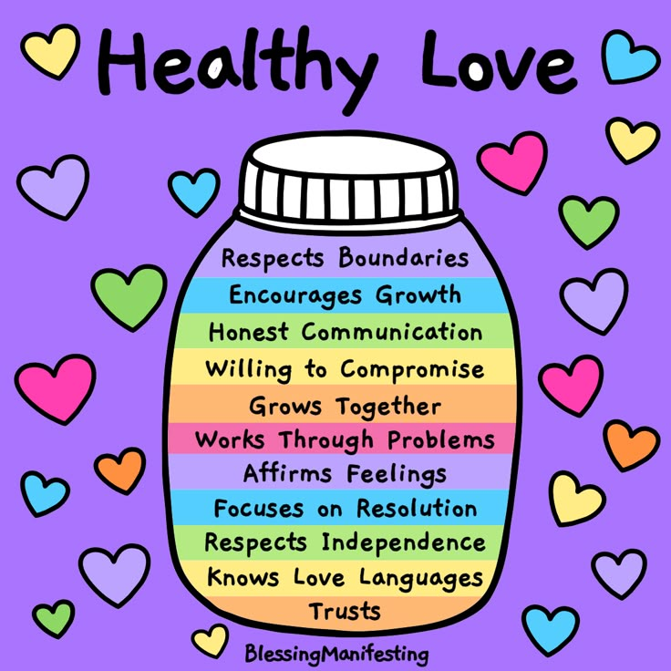
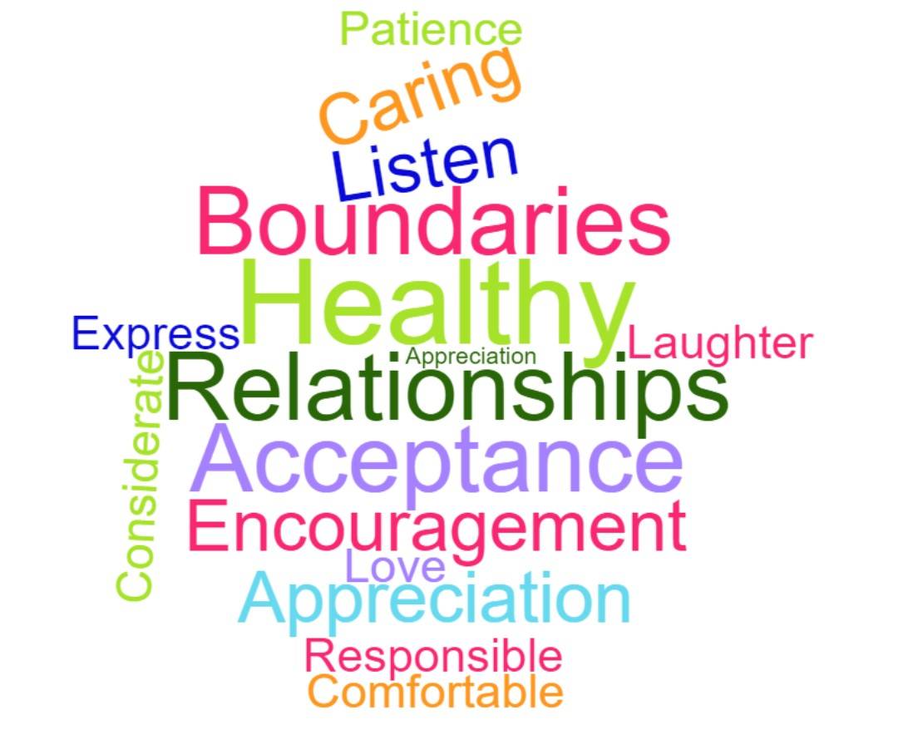
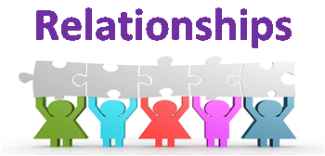
Relationships - Year 6
Things I should already know
How to manage friendships and peer influence
Physical contact
Feeling safe
Responding respectfully to a wide range of people
Recognising prejudice and discrimination
Vocabulary
Attraction | a force that pulls things together, or something that draws people towards it
Romantic Relationship | a close connection between two people who have strong feelings of love, affection, and admiration for each other.
Civil Partnership | a legal, committed relationship between two adults (same-sex or opposite-sex) that offers similar rights and responsibilities to marriage
Marriage | a special, legal, and formal commitment between two people who love each other and choose to spend their lives together
Pressure | the feeling that someone is pushing you—or influencing you—towards a certain choice or behaviour, whether it is good or bad
At the end of my learning I will know
Families and friendships
Attraction to others; romantic relationships; civil partnership and marriage
Safe relationships
Recognising and managing pressure; consent in different situations
Respecting ourselves and others
Expressing opinions and respecting other points of view, including discussing topical issues

