Slide 1
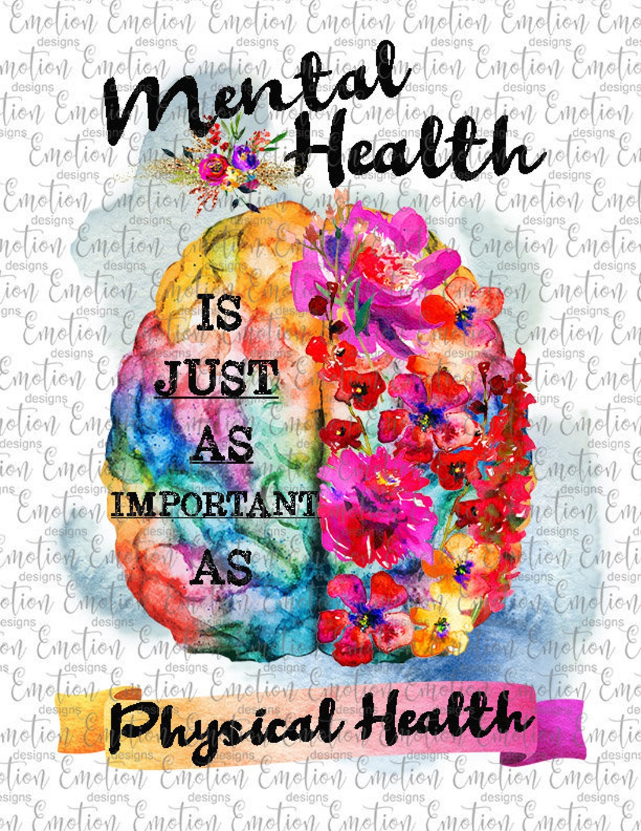

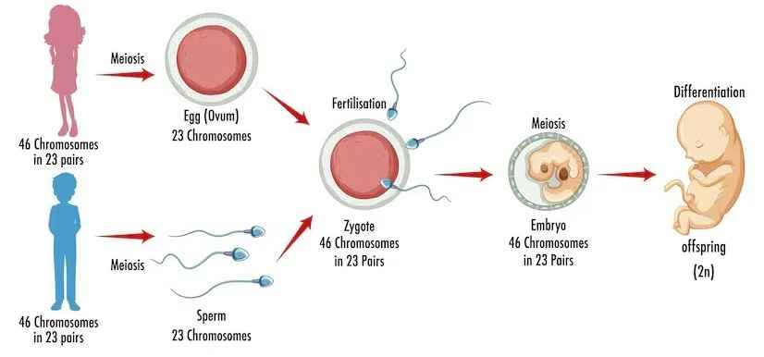
Health & Wellbeing - Year 6
Things I should already know
Healthy sleep habits
Sun safety
Medicines, vaccinations, immunisations and allergies
Physical and emotional changes in puberty
External genitalis
Personal hygiene routines
Support with puberty
Keeping safe in different situations, including responding in emergencies, first aid and FGM
At the end of my learning I will know
Physical health and Mental wellbeing
What affects my mental health and ways to take care of it, managing change, loss and bereavement, managing time online
Growing and changing
Human reproduction and birth, increasing independence, managing transitions
Keeping safe
Keeping personal information safe, regulations and choices, drug use and the law, drug use and the media
Vocabulary
Mental Health | A person’s emotional, psychological and social well-being influencing how they think, feel, act and handle stress.
Bereavement | The period of grief and mourning following the loss of a loved one.
Human Reproduction | A sexual process involving internal fertilisation.
Transition | The process or period of changing from one thing to another.
Drug use | Using of drugs for a non-intended purpose, including recreationally.

