Slide 1
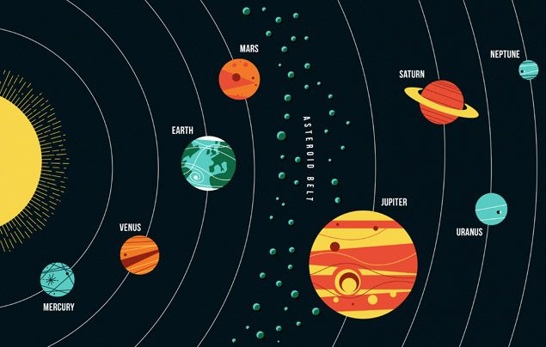
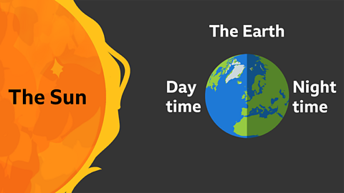
Earth and Space – Year 5
At the end of my learning, I will know
The movement of the Earth and other planets relative to the sun in the solar system.
The name of the main planets in our solar system and order them from their position to the sun.
the movement of the moon relative to the Earth.
That the sun, Earth and moon are approximately spherical bodies.
The Earth’s rotation causes day and night and the apparent movement of the sun across the sky.
That in the past, there were many theories about Earth and Space
Vocabulary
Spherical | To describe something as having a sphere-like shape. 3D rounded shape, like a ball.
Theory | A well supported explanation about how something in the world works, usually based on science.
Rotate | To spin in a circle around a central point (axis) or an imaginary line.
Orbit | The regular, repeating path that one object in space takes around another, much larger object.
Axis | The imaginary straight line passing through the centre of a spinning object.
Satellite | Any object that travels, or orbits, in a repeating circle around a larger object in space. They can be natural or man made.
Things I should already know
That Earth is one of the planets in our solar system.
The Earth is moving.
Gravity is a force on Earth.
The Earth is the same shape as a sphere.
Throughout history, ideas have changed.

