Slide 1
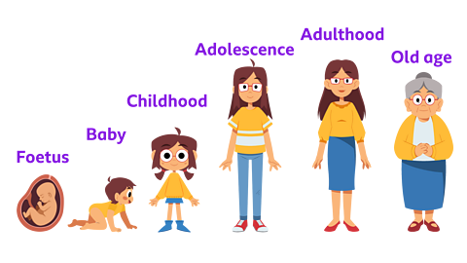
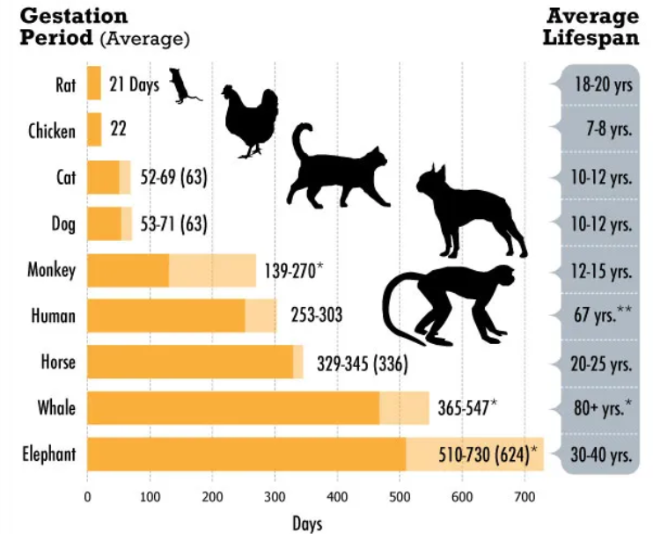
Animals including humans – Year 5
Vocabulary
Puberty | When a child’s body changes and develops into an adult body.
Reproduce | To make more of something. To make a copy that is exactly like he original.
Foetus | A developing baby growing inside a mother’s womb.
Adolescent | A young person who is in the stage of life changing from a child to an adult.
Gestation | The length of time it takes for a baby to grow and develop fully in the mother’s womb.
Things I should already know
Animals, including humans, have offspring which grow into adults.
A variety of common animals that are carnivores, herbivores and omnivores.
The basic parts of the human body and which sense they are associated with.
A variety of common animals and compare their structure (fish, amphibians, reptiles, birds and mammals)
Find out about and describe the basic needs of animals, including humans, for survival.
Describe the importance for humans of exercise, eating the right amounts of different types of food, and hygiene.
At the end of my learning, I will know
Describe the changes as humans develop to old age.
explain the changes that takes place in boys and girls during puberty in order to reproduce.
Can explain how a baby changes physically as it grows, and also what it is able to do
Explain the changes that occur as a person reaches old age.

