Slide 1
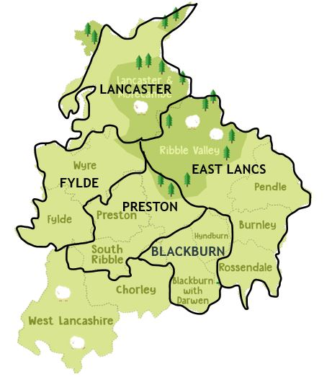
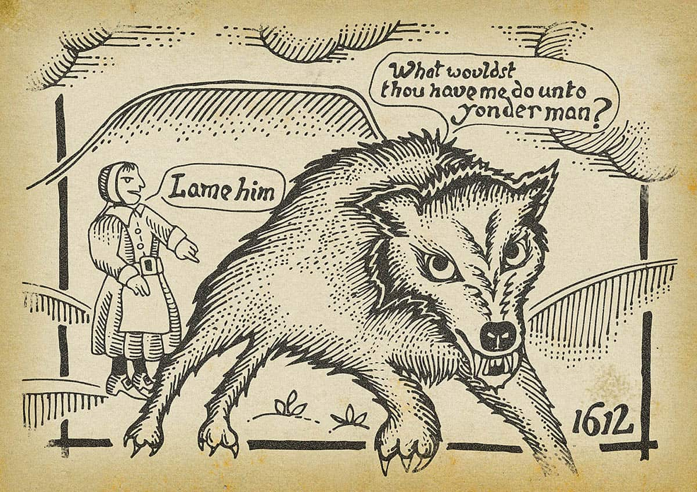
A Local History Study, The Pendle Witch Trials–
Year 5
Things I should already know
British history prior to 1600 and how people’s lives have shaped the nation.
How Britain has been influenced by the wider world.
The role of Kings and Queens and their links to religion.
A knowledge of ancient civilisations and their contributions to society.
Some aspects of History in 1600 for example; religious struggles and disease.
At the end of my learning, I will know
Locate Pendle and Lancaster on the map and their proximity to Preston.
What Lancashire was like in 1612.
How society identified a ‘witch’ in 1612.
Use evidence from the Pendle Witch Trials to form an opinion.
Recognise the events that occurred to cause a trial and execution.
Identify the people involved and their role.
Make connections between the Pendle witch trials and people’s beliefs in 1612.
Key Vocabulary
Parliament | A group of people who are elected to meet and debate issues, pass laws and set taxes.
Execution | In 1612, some crimes were punished by death. This was usually in front of the public and most commonly hanging.
Trial | Examination of evidence by a judge and jury, to decide if someone is guilty of a crime.
Pedlar | A person that travels around the country selling goods.
Rural | A place with low population, open spaces, farmland and small spaced-out settlements. The countryside.
Familiar | A witch’s spiritual companion, often in the form of an animal.

