Slide 1
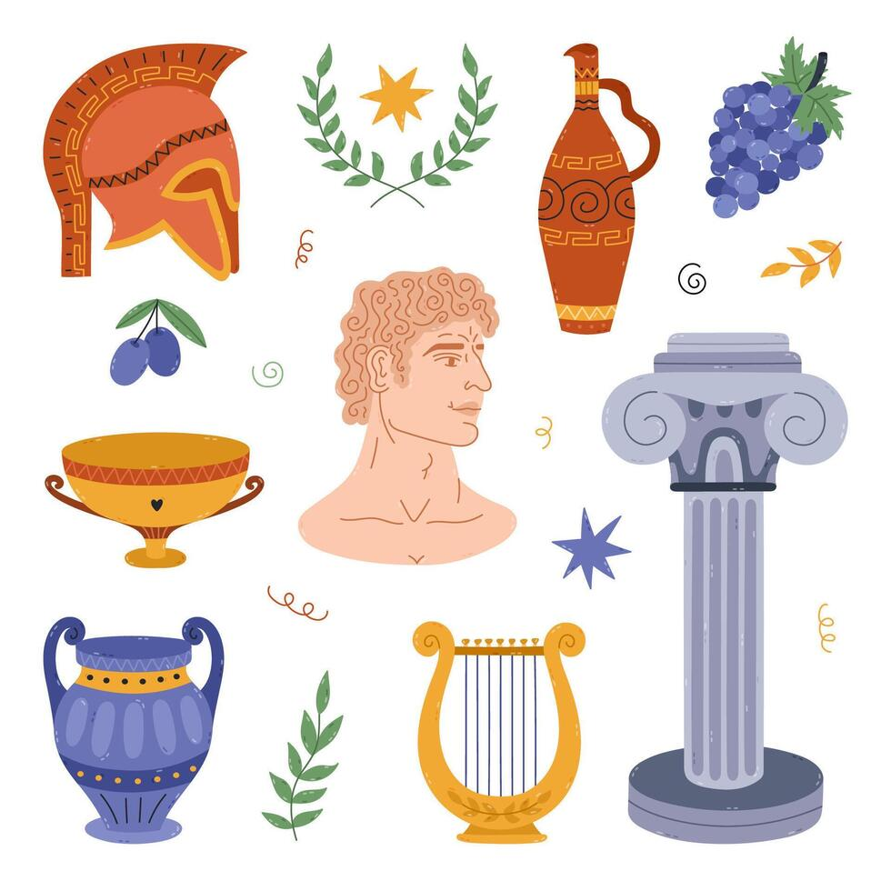
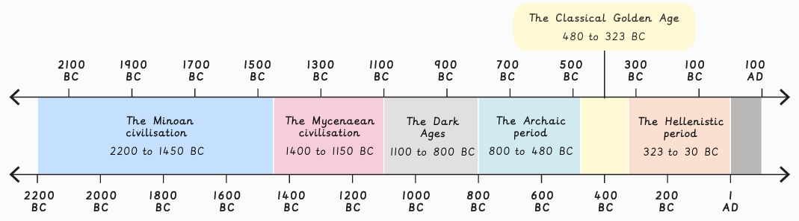
The Ancient Greeks – Year 5
At the end of my learning, I will know
Describe the features of Ancient Greece.
Identify the key periods in the ancient Greek civilisation.
Research the Greek gods and make inferences.
Compare Athens and Sparta.
Understand the different types of democracy.
Explain how Athenian democracy worked.
Explain what philosophy is.
Identify the achievements of the ancient Greek philosophers.
Identify the ancient Greeks’ legacies and their impact.
Key Vocabulary
Democracy | A system of government where power is given to the people, who vote directly on laws and policies or elect a representative to vote for them.
Philosophy | A study of how the world works and why we do the things we do. It is a love of wisdom.
Oligarchy | A type of government where a small, wealthy, powerful group holds all the control. Meaning “few rule”
Boule | A council of citizens appointed to run the daily affairs of a city-state.
Legacy | Leaving things behind as a way of sharing unique gifts, values, ideas or stories.
Civilisation | A large group of people who share certain advanced ways of living and working together in cities.
Things I should already know
When Britain’s stone age – iron age occurred and the changed that happened.
That other Ancient Civilisations also existed in other parts of the world e.g. Maya and Egyptians.
That Ancient civilisations Had ideas and inventions that we still use today.

