Slide 1
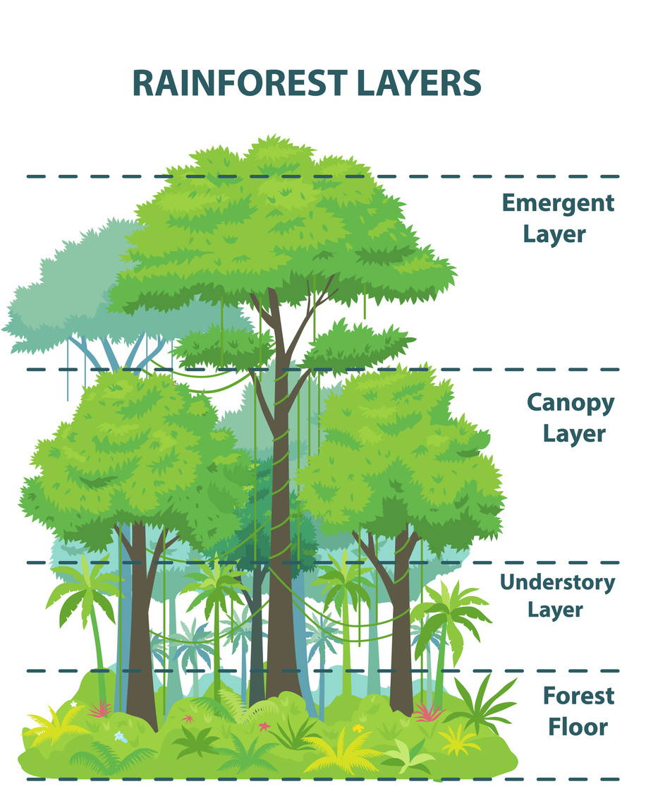
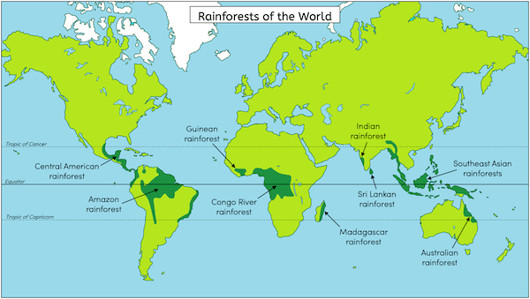
Rainforest– Geography Year 5
Things I should already know
How to use maps, atlases and globes to locate the world’s continents and countries.
Understand the meaning of human and physical characteristics in Geography.
Identify the capital cities for the UK countries
Identify the world’s oceans.
Know that places can be hot or cold depending on their proximity to the equator.
Key Vocabulary
Equator | an imaginary line around the middle of the Earth, that divides it into the top half (Northern Hemisphere and Southern Hemisphere). It's the hottest part of Earth
Biome | Regions of the world with similar climate, animals and plants.
Indigenous | The original inhabitants of a region with their own cultures and language.
Deforestation | Deliberate and permanent removal of forests and trees.
Species | A group of living things that have similar characteristics and when together, can reproduce.
Emergent Layer | The highest, topmost layer of trees. Consists of trees that require a lot of sunlight.
Canopy Layer | The second tallest layer of trees that form a dense roof over the forest.
Understory Layer | A dark humid layer of the rainforest, below the canopy. Filled with plants and young trees.
At the end of my learning, I will know
The location of rainforests around the world.
The countries and major cities in South America.
Understand the biome of the rainforest.
To know about the people and settlements in the Amazon Rainforest.
Understand the importance of the rainforest and the threats that the rainforest faces.
Compare the Amazon Rainforest to other locations in the world.

