Slide 1
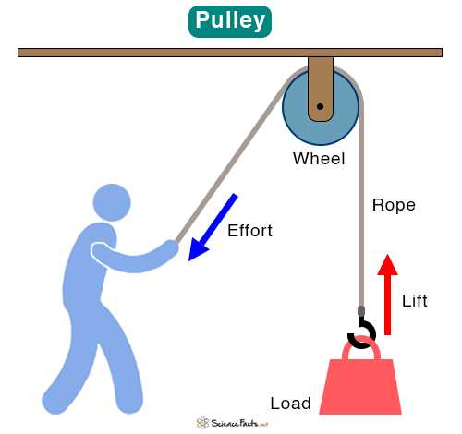
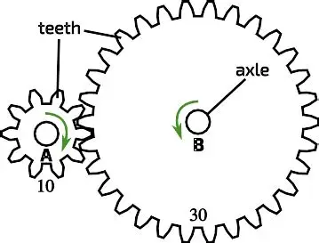
DT Gears and Pulleys– Year 5
Things I should already know
Design purposeful, functional, appealing products for themselves and other users based on a design criteria
Know that mechanisms are a system of parts that work together to create motion
Recall that pneumatic systems can be used as part of a mechanism.
Develop a design criteria from a design brief and generate suitable ideas using thumb nail sketches and exploded diagrams.
At the end of my learning, I will know how to
Give examples of machines that use gears and/or pulleys.
Describe how gears and pulleys work and their purpose.
Design and make a gear and pulley system.
Write a problem statement.
Write questions for market research, provide feedback and research market competitors.
Write and use a design brief to guide design.
Evaluate a product against a set of design criteria, provide useful feedback and incorporate changes.
Draw and annotate an eco-gadget bike design.
Vocabulary
Axle | A bar that goes through the centre of a wheel. It allows the wheel(or gear) to spin or turn.
Force | A push or a pull that makes an object move, stop, change speed, or change direction.
Input | Putting information, force, or energy into a machine or system.
Output | The final result, product, action or information that comes out of a machine, system, or process.
Gear | A round wheel with teeth that locks with other gears to transfer power, speed, or direction in machines.
Mechanism | A set of moving parts that work together inside a machine to make it do a specific job.
Pulley | A simple machine made of a wheel with a groove for a rope or cable, designed to make lifting heavy objects easier.
Sustainability | Doing little or no harm to the environment.

