Slide 1
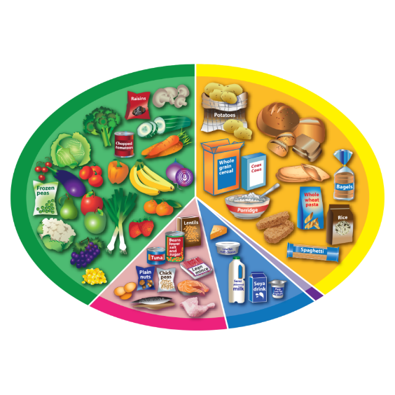
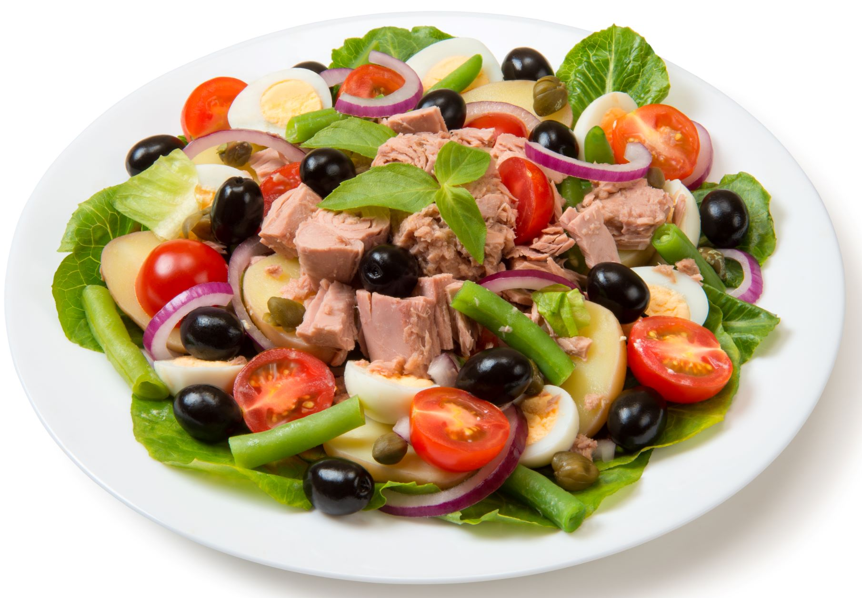
DT Serve a Salad– Year 5
At the end of my learning, I will know how to
recall and discuss different types of salad.
identify salad ingredients and sort them into the correct food groups.
explain that a third of the food we eat should come from the Fruit and vegetable group and a third should come starchy carbohydrates group.
recall that some foods provide fibre and explain the role of fibre in the diet.
recall and explain the get ready to cook steps.
prepare ingredients by safely using the bridge hold, claw grip and grating techniques.
recall foods associated with a selection of countries around the world.
identify design criteria for a salad based around the requirements of an individual and purpose.
Things I should already know
The main messages from each Eatwell Guide food groups.
Identify and classify ingredients in composite dishes.
The size of the food groups shows us the proportion in which different types of foods are needed for a healthy diet.
Recall and carry out the getting ready to cook steps.
Examples of foods available in different seasons and a benefit of choosing seasonal food.
Vocabulary
Nutrition | The study of food and how your body needs healthy ingredients to grow, repair itself, and keep you strong.
Savory | Food types that aren’t sweet.
Seasonality | The times of year when foods, such as fruit and vegetables, are ripe and ready to eat.
Aesthetic | How food looks appealing thinking about colour, shape, texture and presentation.
Hygiene | Keeping food handling, storage and preparation clean, safe and healthy to eat.
Ingredients | The different foods that are put together to create a particular meal/dish.
Varied | Having many different types of food/ food from different food groups.
Evaluate | Carefully judge the value, quality, or importance of something to decide how good or bad it is.

