Slide 1
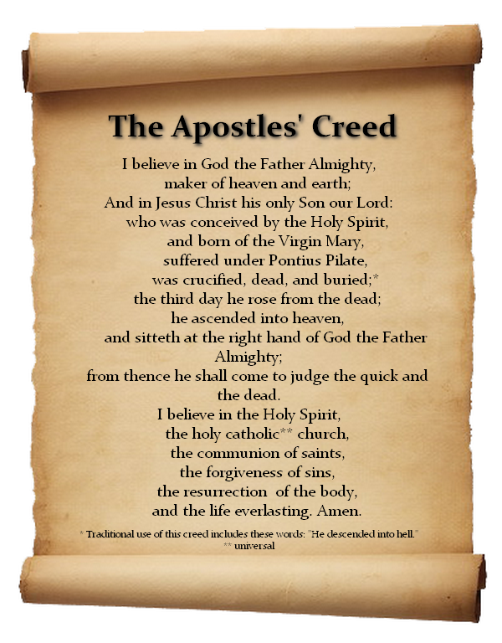
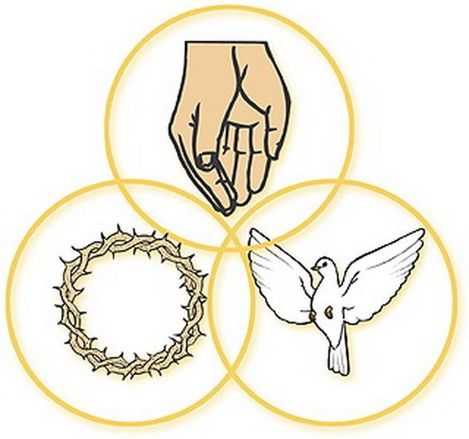
RE, Christianity ‘Church’– Year 5
At the end of my learning, I will know
What is meant when Christians talk about one God in Trinity.
Identify the beliefs contained within the Apostle’s Creed
Explain why the Christian community (the church) might want/need an agreed statement of belief.
Describe and explain the meaning of a range of symbols that might e used for the Trinity.
Explain how symbols might unite the worldwide Christian church.
Describe the role of places like Taizé where Christians from different backgrounds might come together to worship.
Consider what we mean by sources of authority.
Things I should already know
Know the meaning of the terms ‘Temptation’ and ‘Sacrifice’.
Understand how the last supper links with the Eucharist.
Investigate the different parts of a church including items used during the Eucharist.
The symbols used during Pentecost.
How the holy spirit was important to the disciples.
Vocabulary
Worship | To give religious devotion, honour and love to God
Trinity | One God that exists as 3 distinct persons: God the Father, God the Son and God the Holy Spirit.
Apostle | A special follower sent to share Jesus’ message.
Symbol | A picture, shape or object that is used to represent an idea or information.
Unite | Joining together to form one group or work as a team.
Creed | A set of strong beliefs, principles or rules, that guide how a person or group lives and acts.

