Slide 1
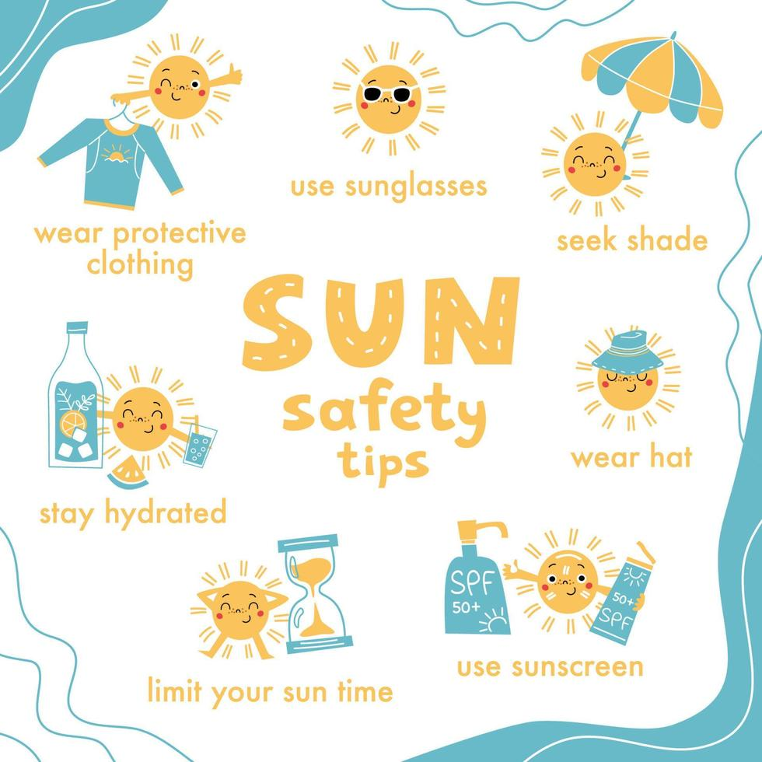
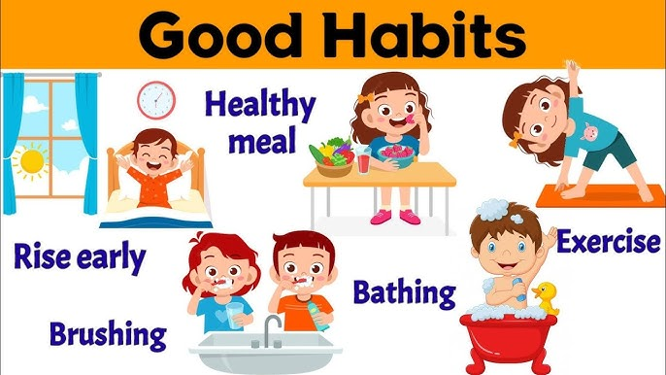
Health and Well Being – PSHE – Year 5
Word | Meaning
Puberty | the time in life when a child’s body begins to develop and change into an adult body.
Genitalia | the parts of the body on the outside, between the legs, that are different between boys and girls. ’Private’ body parts
Immunisation | Putting a substance (vaccine) into your body so that it can learn to fight infections.
Allergy | when someone’s immune system gets confused and tries to fight things that are actually safe and harmless, such as pollen, pet fur, or certain foods
Puberty
First Aid
Hygiene
Things I should already know:
Maintaining a balanced lifestyle; oral hygiene and dental care.
Health choices and habits; what affects
feelings; expressing feelings.
Personal strengths and achievements; managing and reframing setbacks.
Risks and hazards; safety in the local environment and unfamiliar places.
Sleep Routine
At the end of my learning, I will:
Healthy sleep habits; sun safety; medicines, vaccinations, immunisations and allergies
Physical and emotional changes in puberty; external genitalia; personal hygiene routines; support with puberty.
Keeping safe in different situations, including responding in emergencies and first aid.
Sun Safety
Risky Situations

